Slide 1
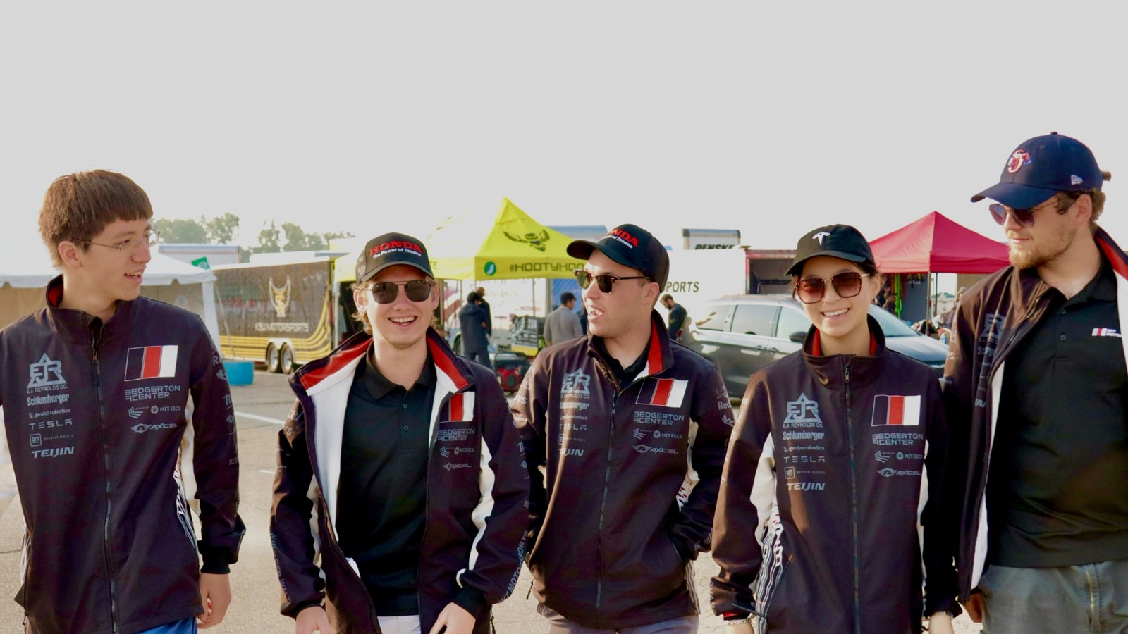
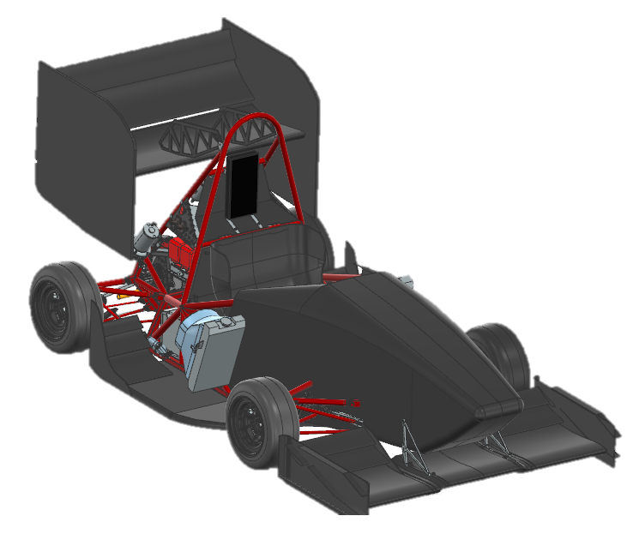
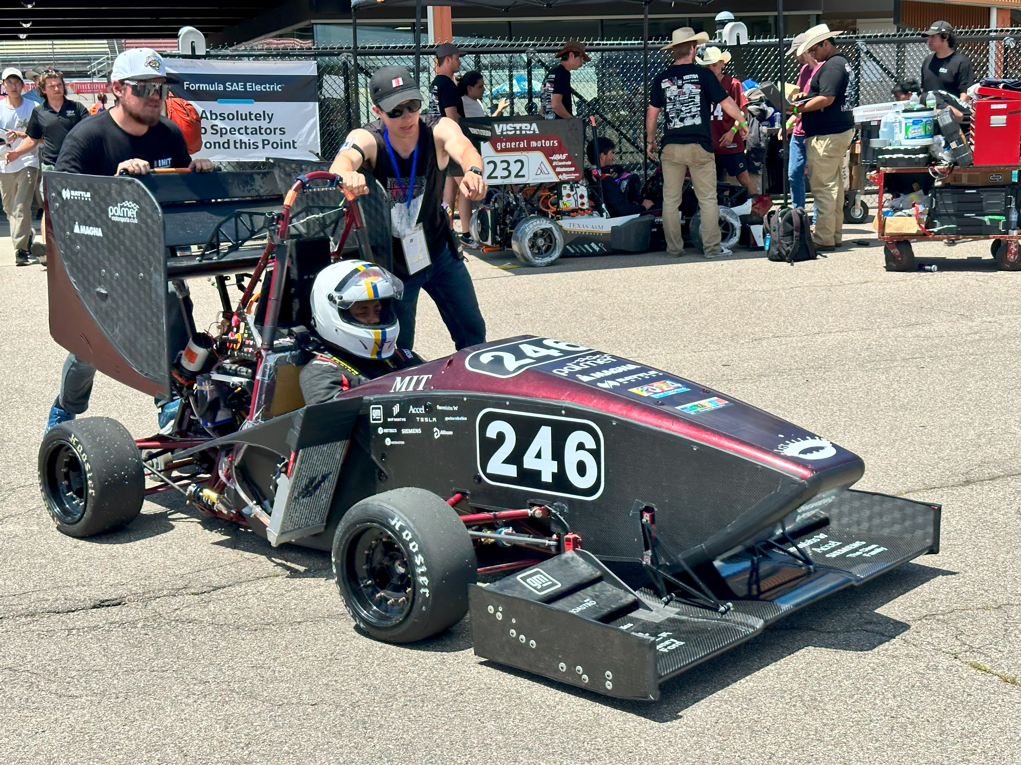
Formula SAE at MIT
MIT students building racecars!
60 students
12 months
∞ Redbull
Aaron Becker
10 / 25 / 2024
Notes:
Maximum character recommendations:
Contact info: 145
Main title: 38
Secondary title: 100
Update all text fields with your relevant information.

Slide 2

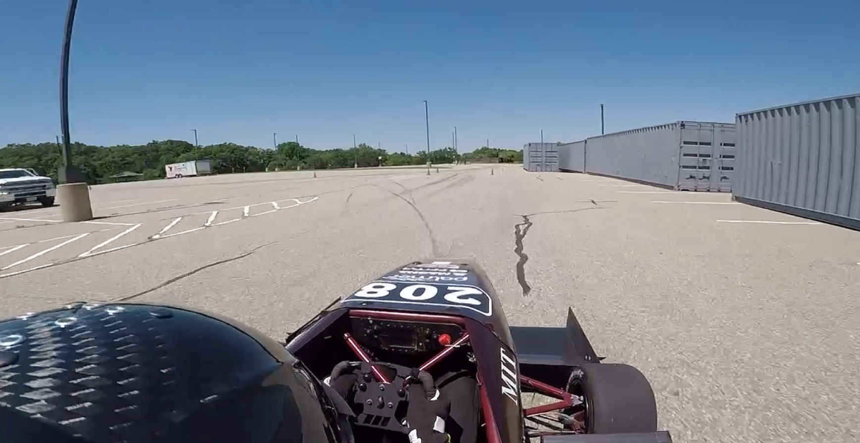
What’s FSAE all about?
That’s my friend Vincent
I worked on that
(the part that holds the wheel on)

Slide 3
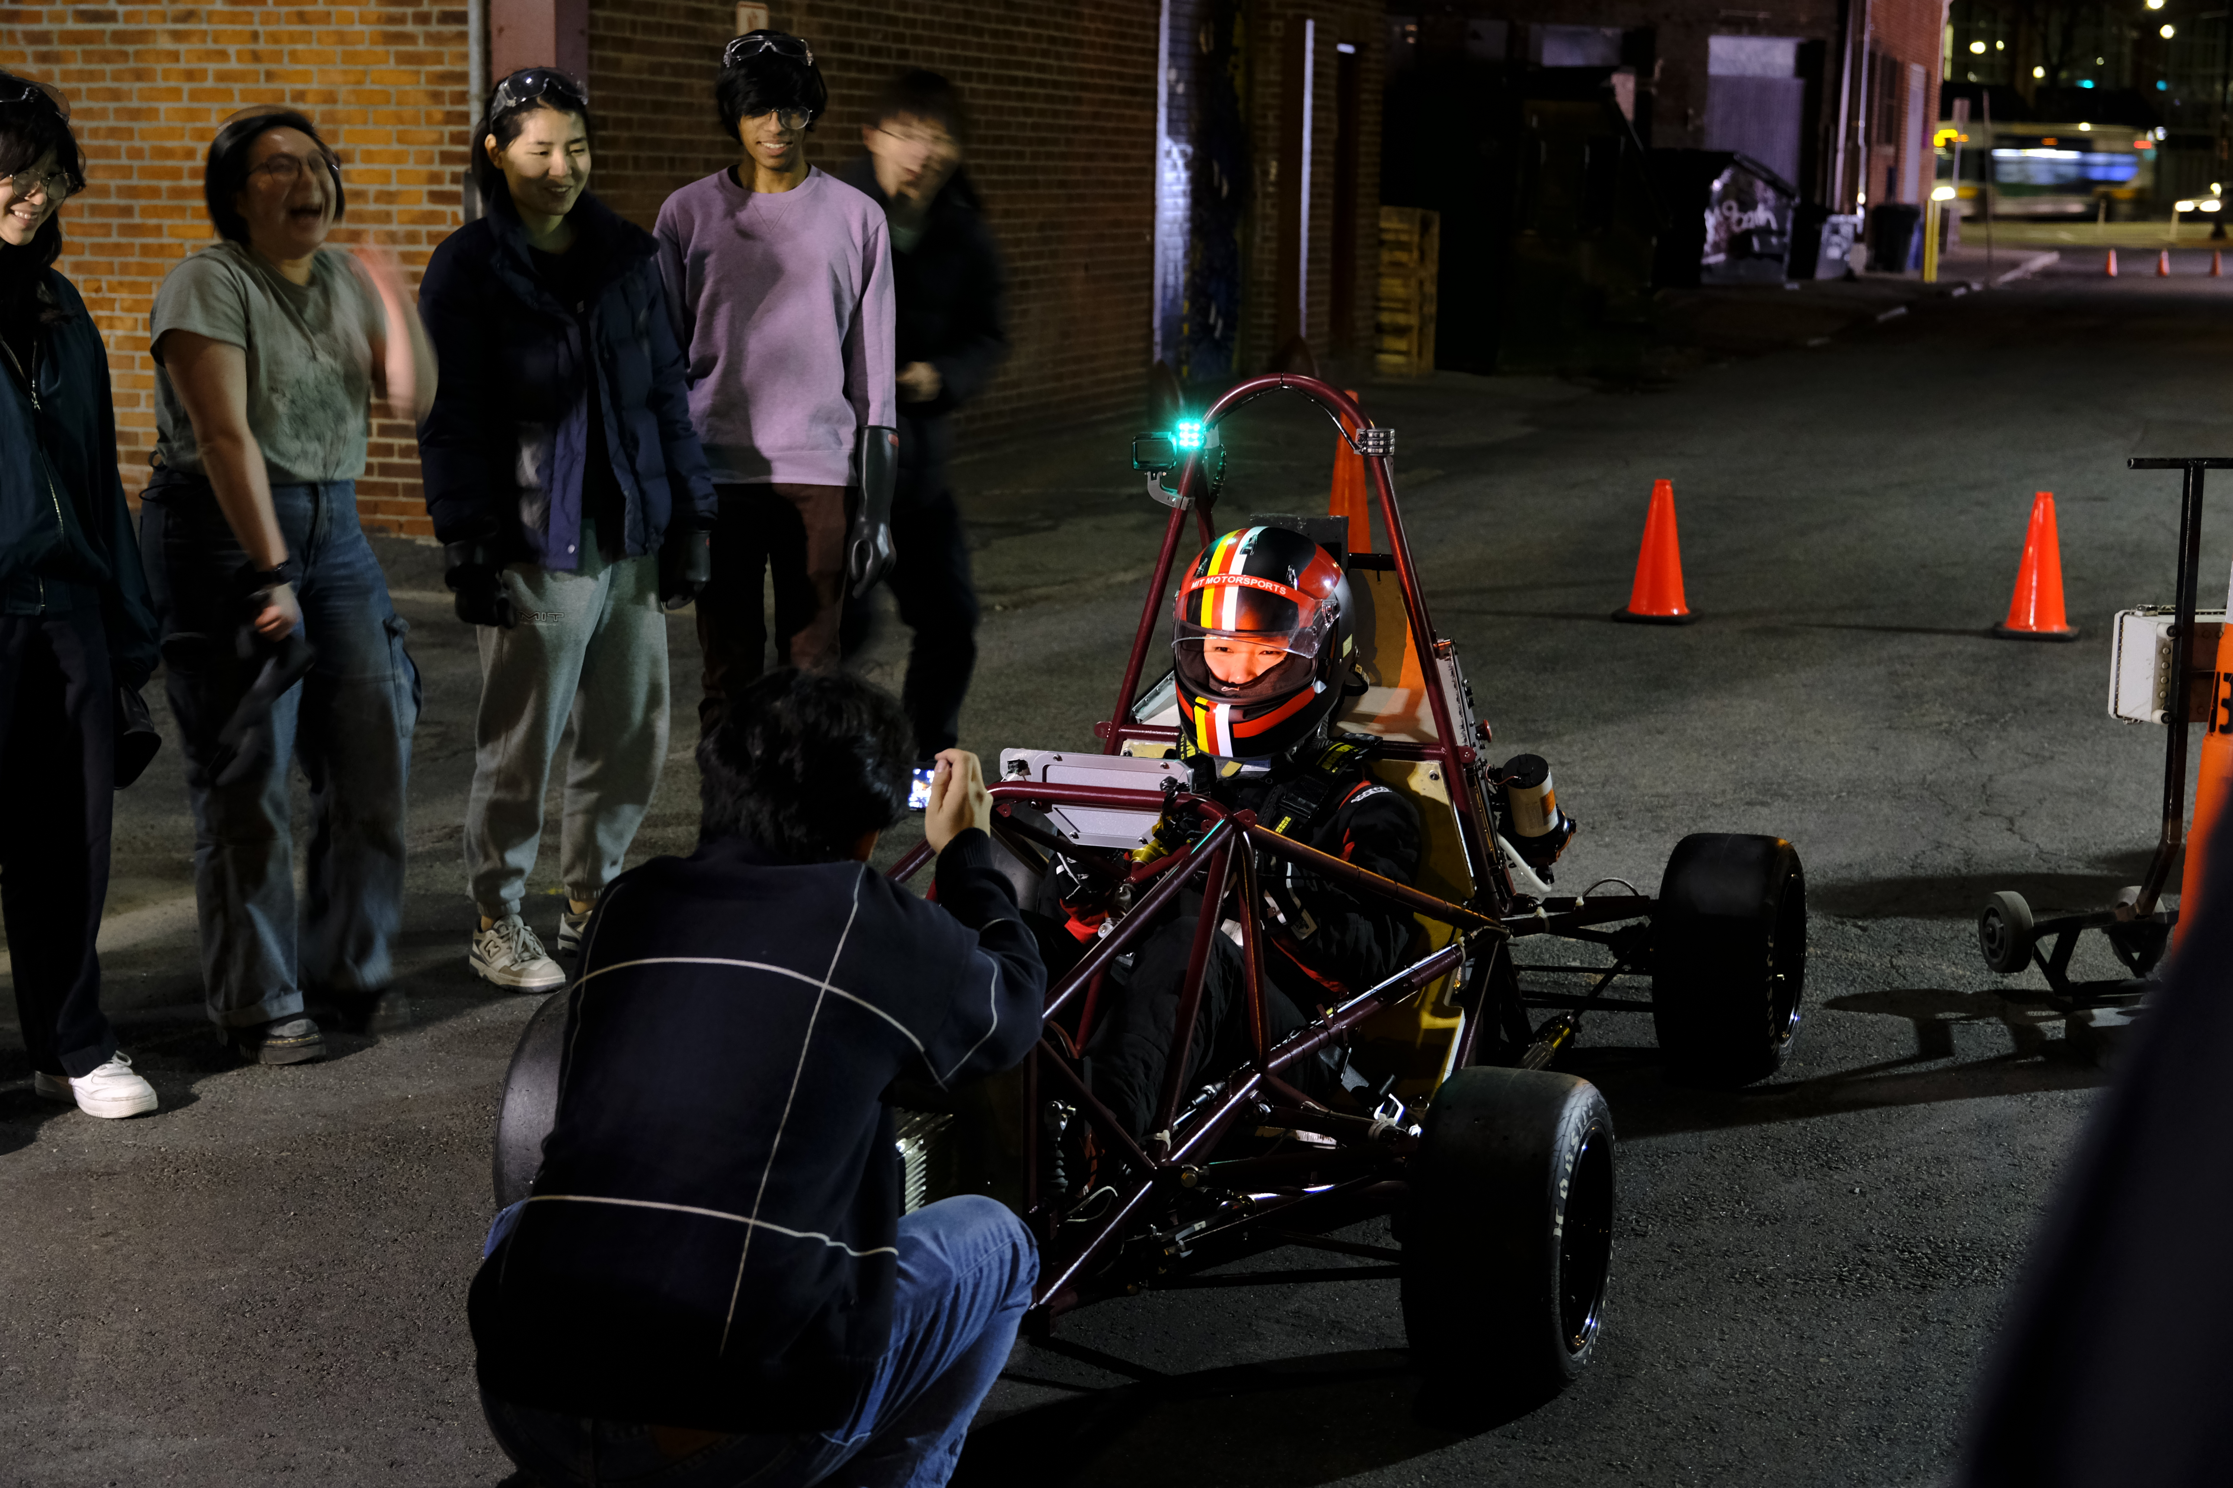
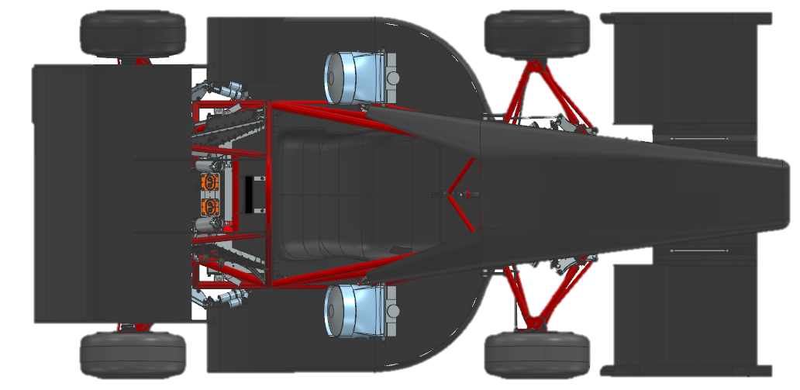
What’s FSAE all about?
Build fast (electric) cars, and race them safely
Learn to be great engineers by following a design process
Have fun!

Slide 4

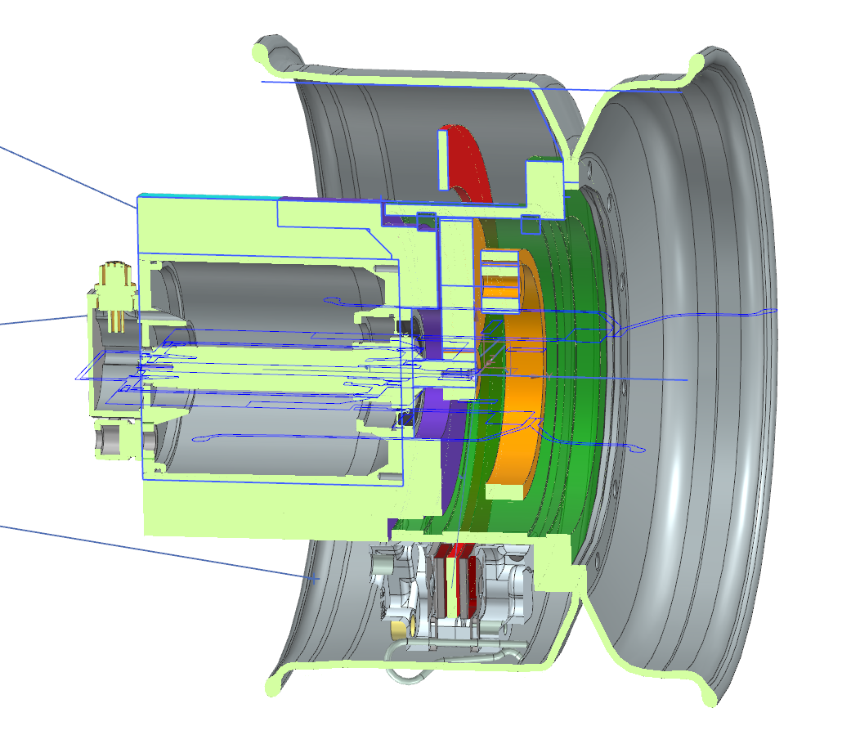
The “Upright”
Let’s follow a part!
Explain a year-long “design cycle”
Talk about some of the fantastic resources at MIT that make it possible!

Slide 5
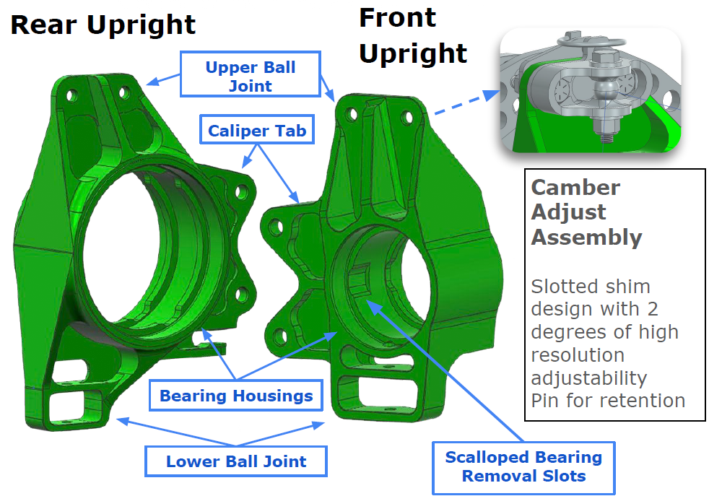
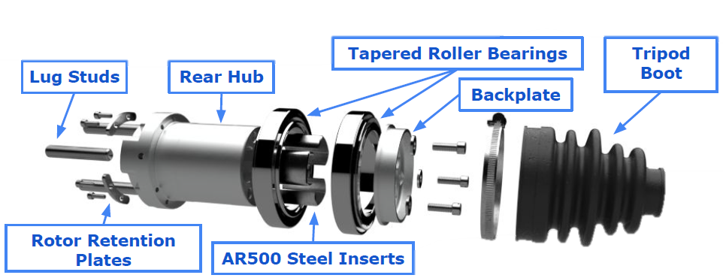
Let’s follow a part!
Upright breakdown. How did we get here?
There’s a lot of complexity – let’s go through it piece by piece

Slide 6
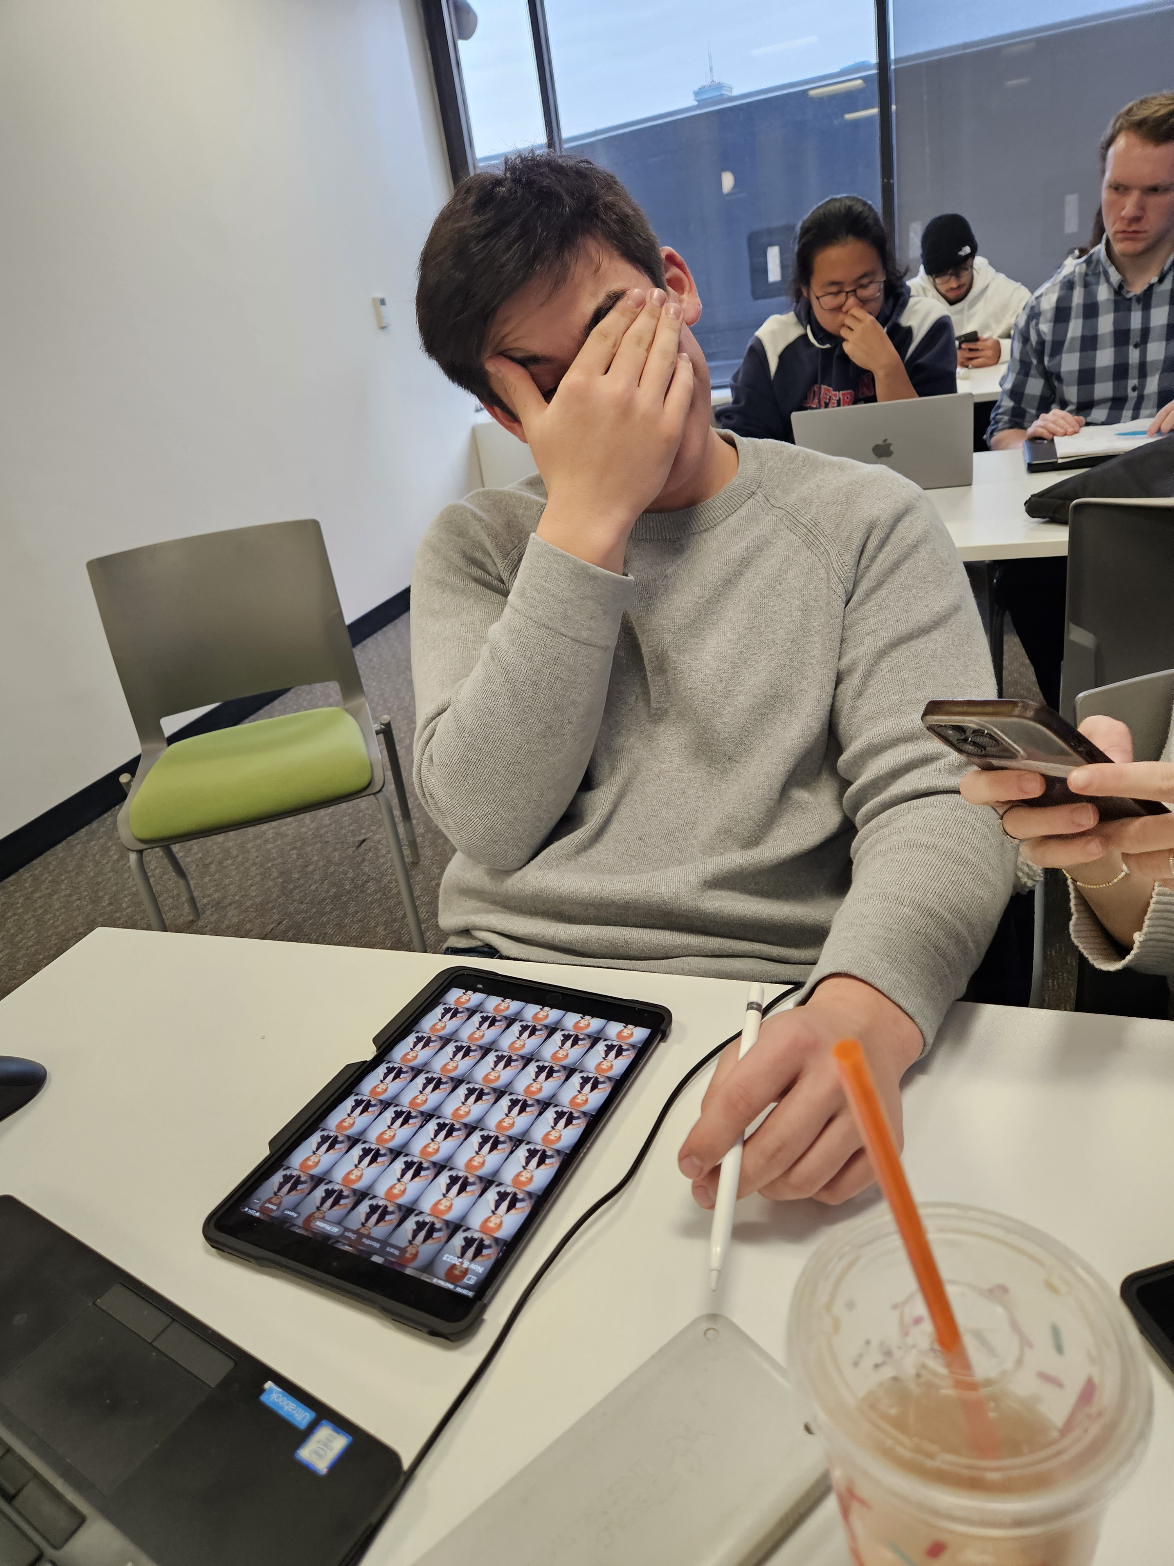
Design Process -
Mirrors industry
DRDR
Design Requirements
CoDR
Concept Review
DR1/2/3
Design Review
MaDR
Manufacturing
Analysis
Peer Review
Testing
At all stages!
A lot of work!
Notes:
Maximum character recommendations:
Contact info: 145
Main title: 38
Secondary title: 100
Update all text fields with your relevant information.
Logo: To add your logo, delete the placeholder logo. Click the placeholder icon and select your logo from your files. Right click and select crop to re-crop your logo to fit in the space. Adjust logo size if logo is more vertical or square in shape.

Slide 7
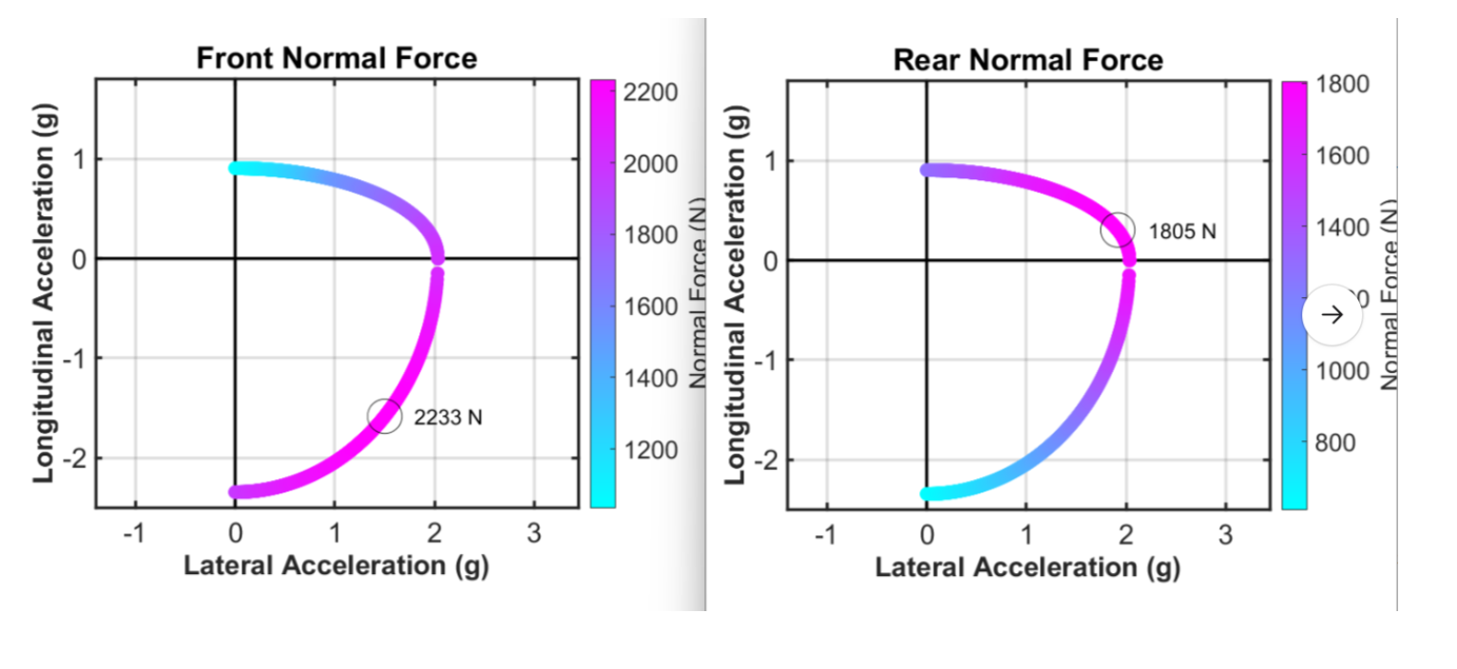
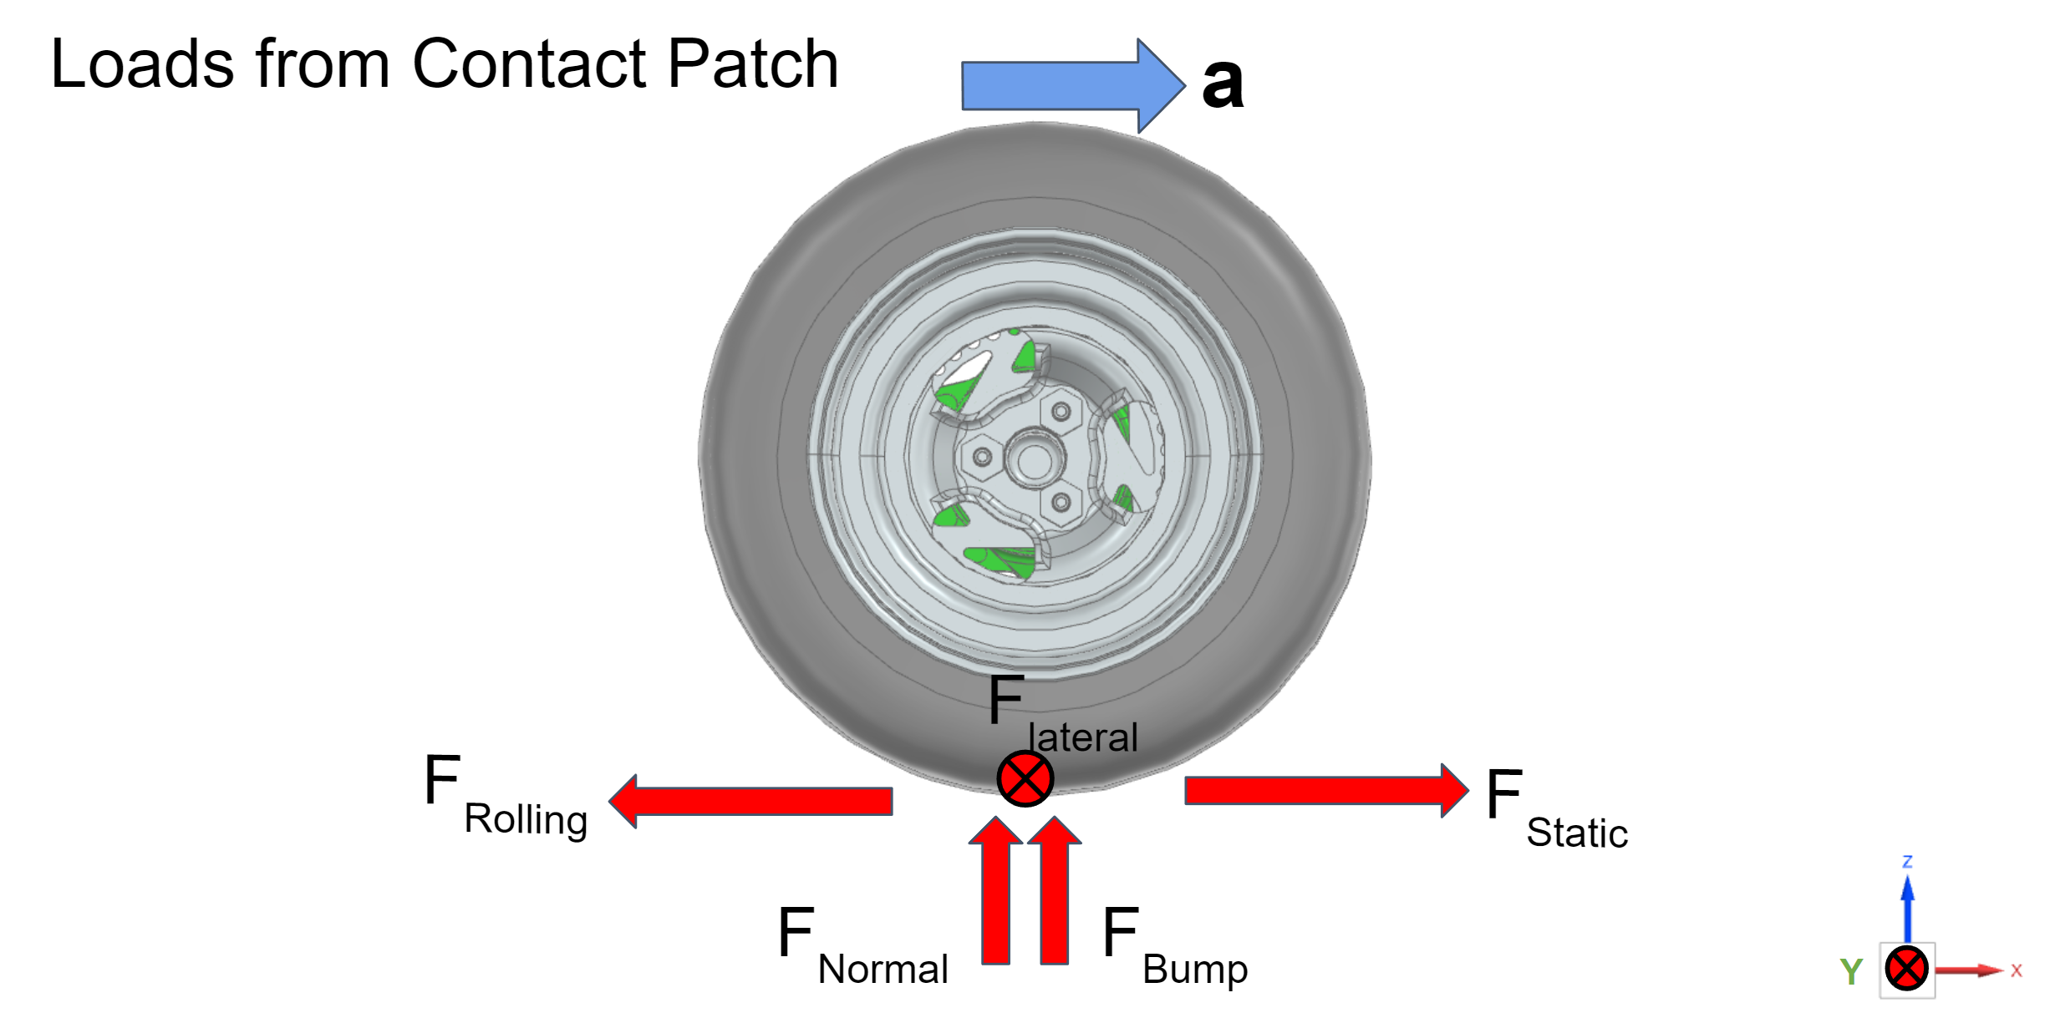
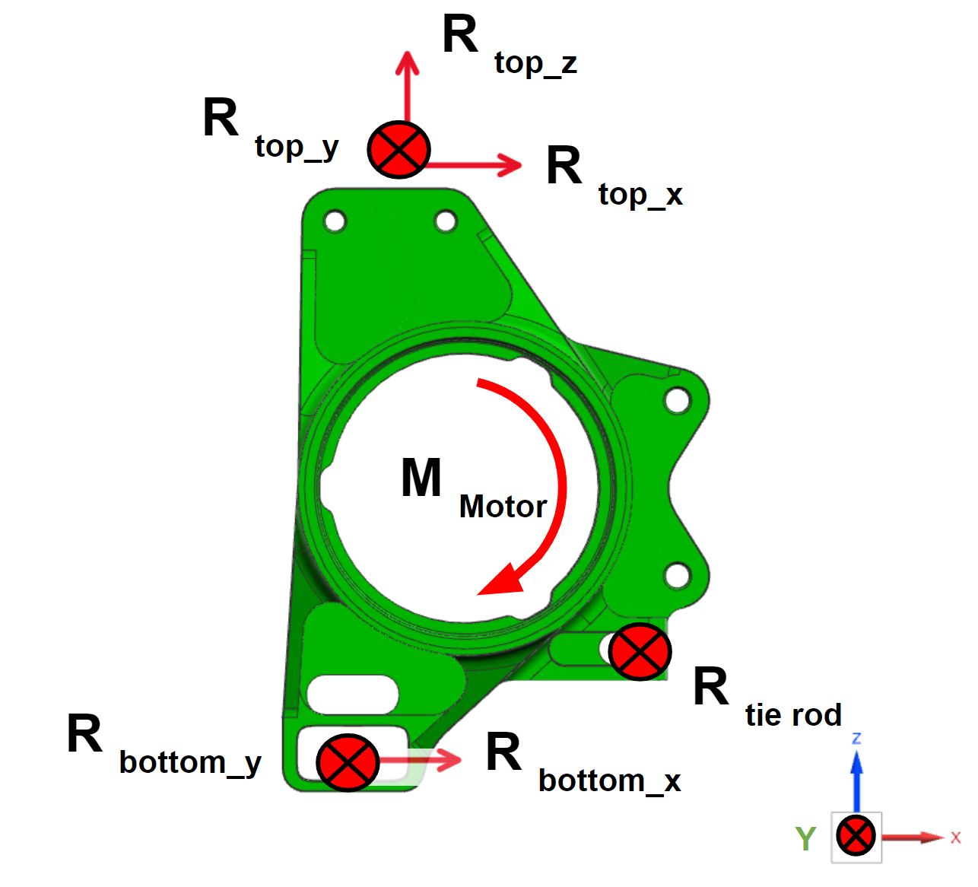
DRDR
Design Requirements
Quantify what you don’t know
Initial Simulation (F vs g’s)
FBDs (8.01 GIR)

Slide 8
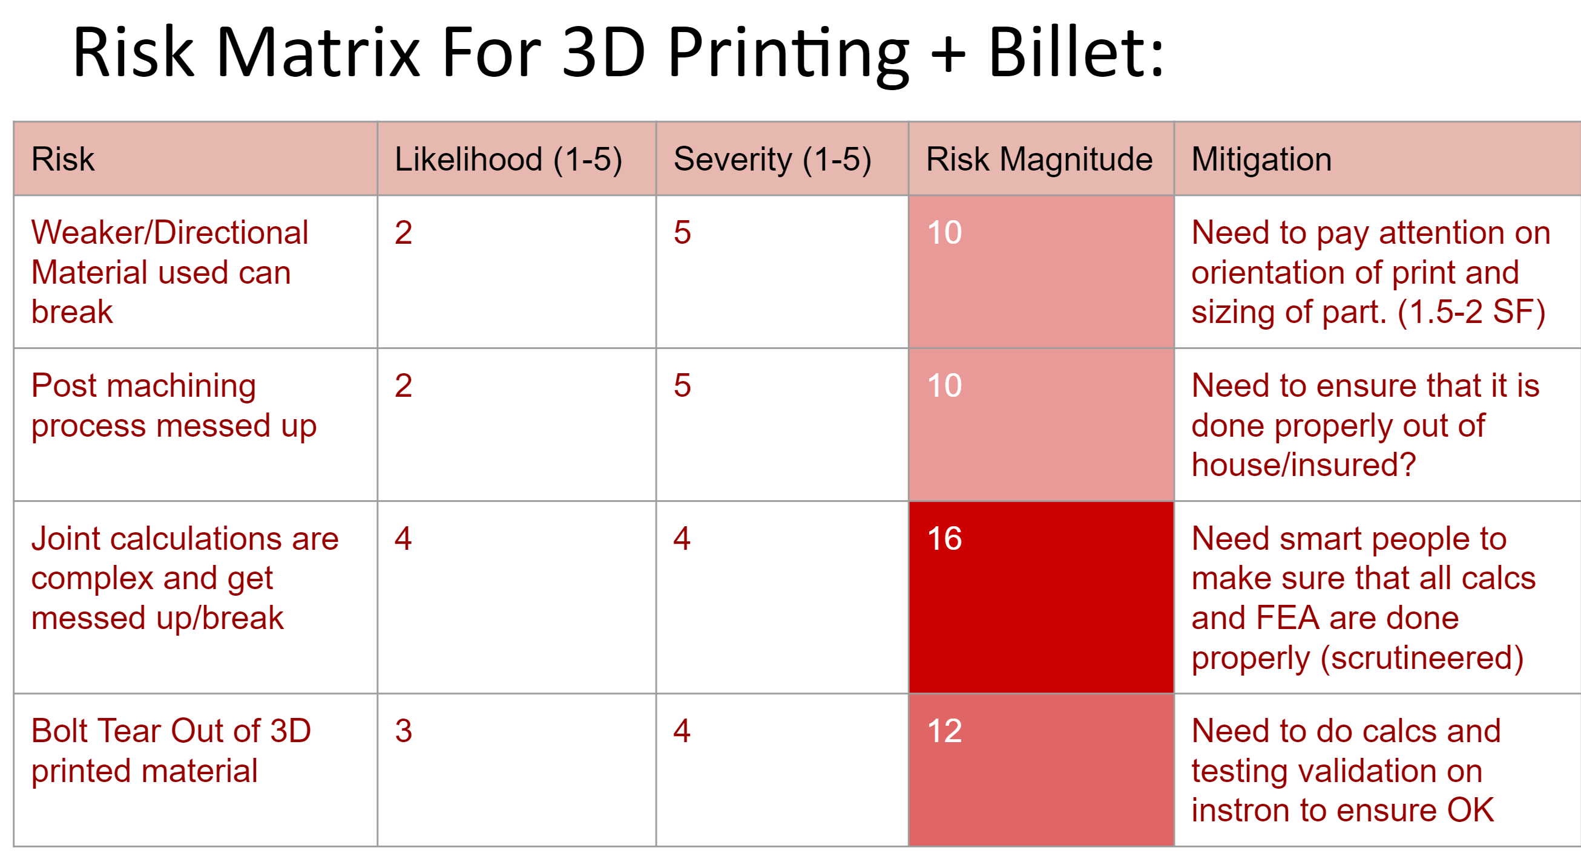
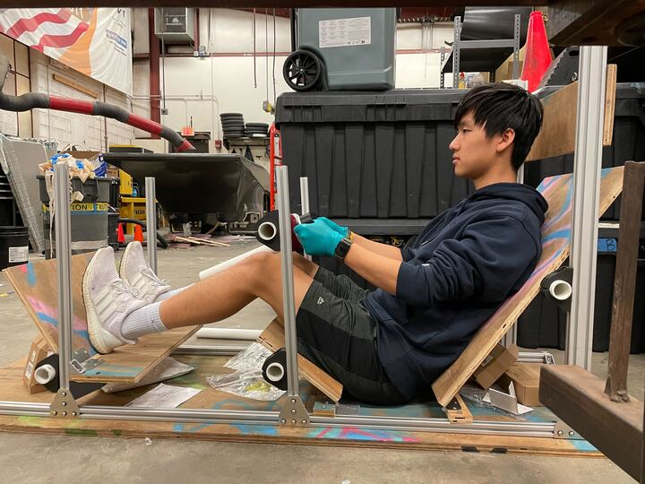
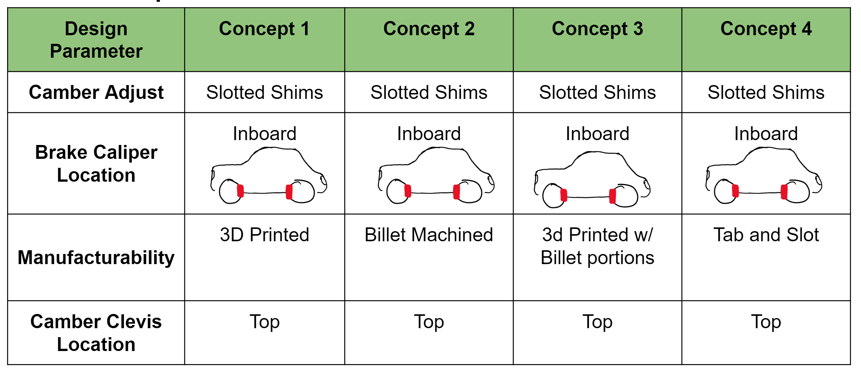
CoDR
Concept Review
Evaluate risks and tradeoffs
Get some real-life data!

Slide 9
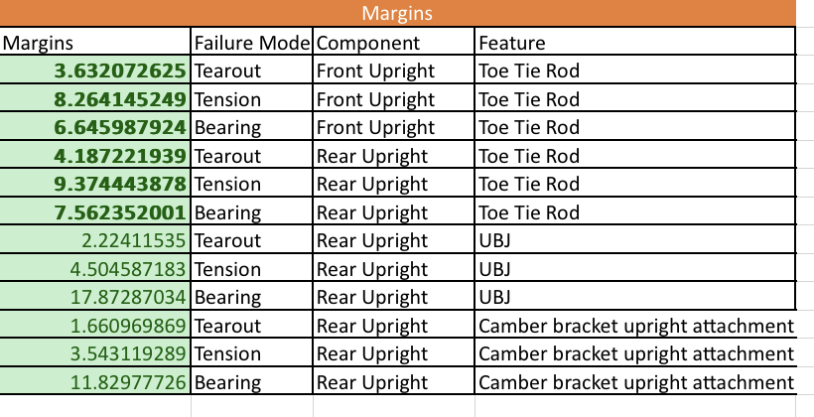
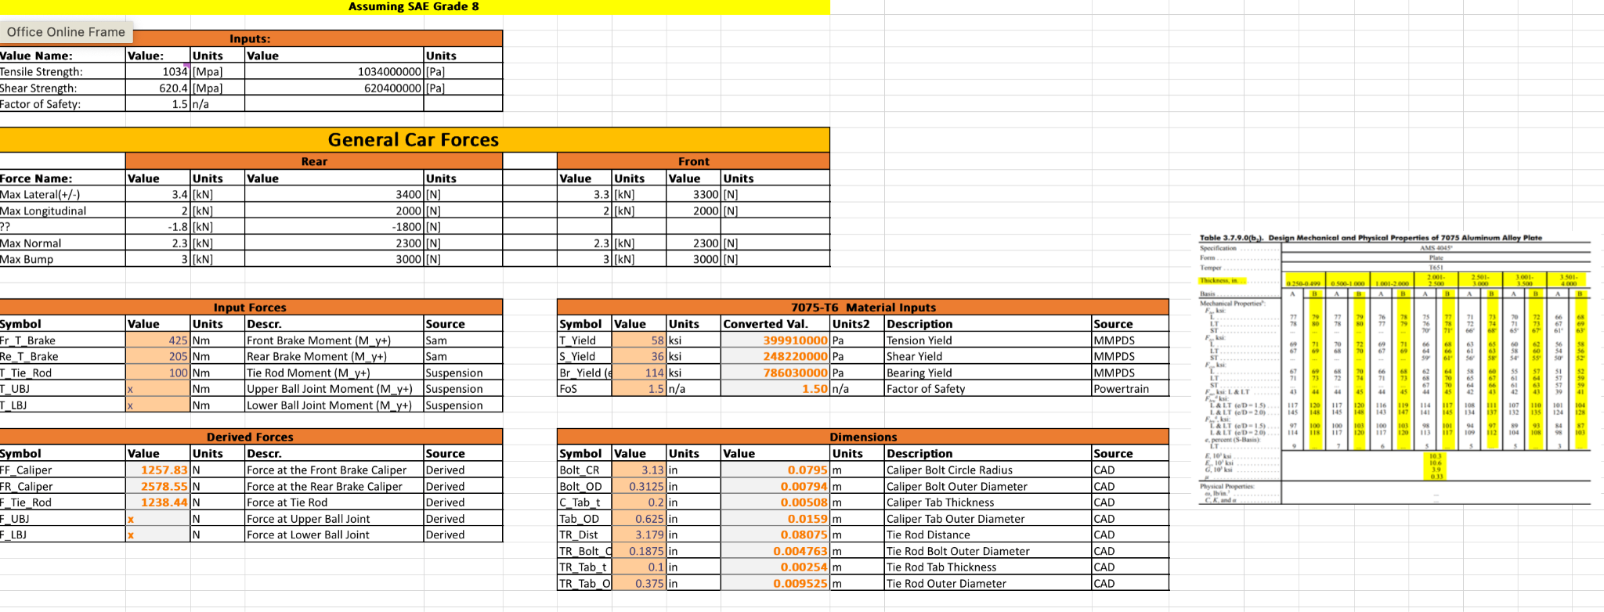
DR1/2/3
Hand calculations
First principles – 2.001. Quick order-of-magnitude estimate
Continue refining concept feasibility
Get rough sizes of parts – “sizing”

Slide 10
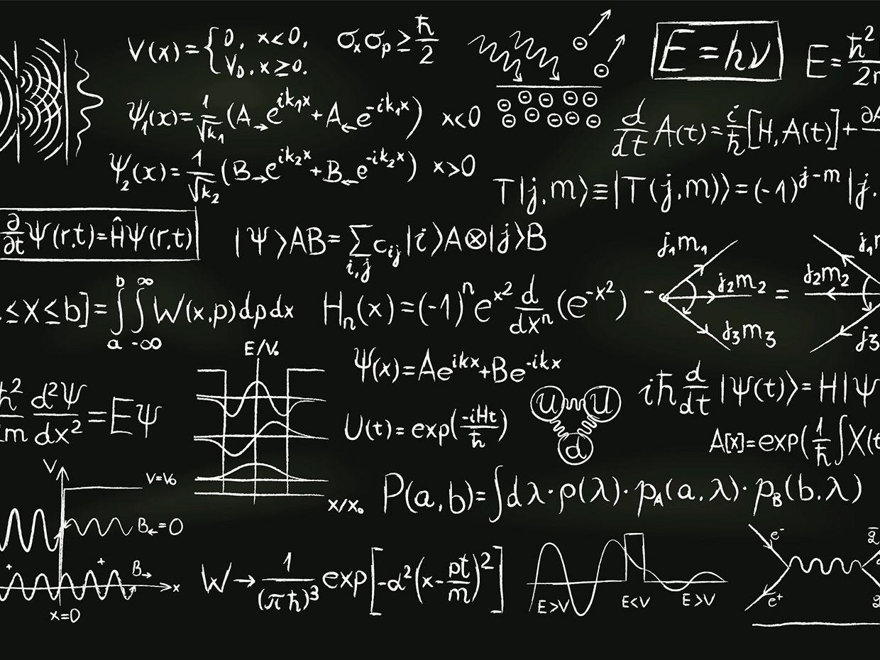
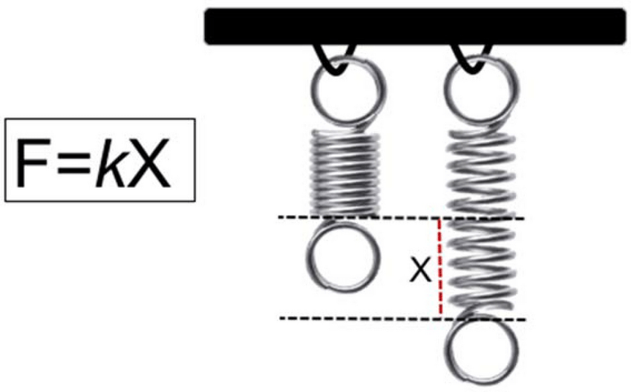
FEM – Finite Element Modelling
Reality is complicated… down to subatomic interactions
Everything is a spring! Simpler = better and less likely to go wrong
VS

Slide 11
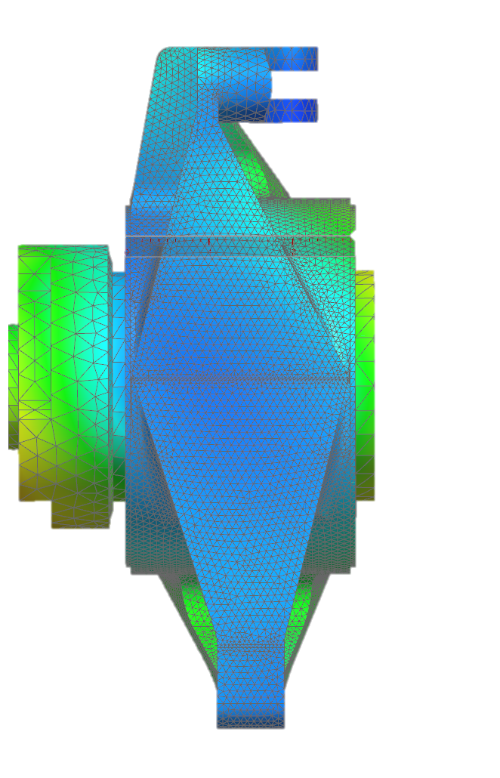
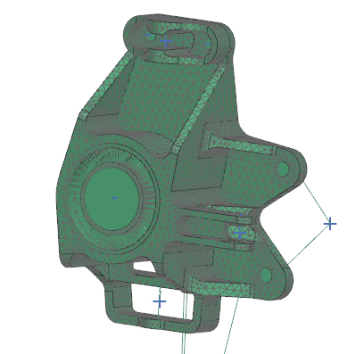
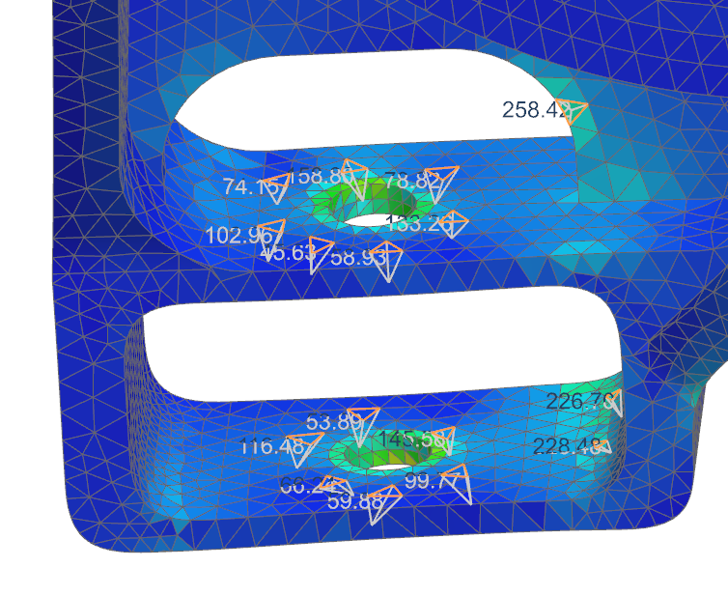
FEM – Finite Element Modelling
What if we used millions of springs?
Computers can do math – fast!
“All models are wrong, some are useful” – George Box
Tons of tiny springs
Simulated Displacement w/BCs

Slide 12
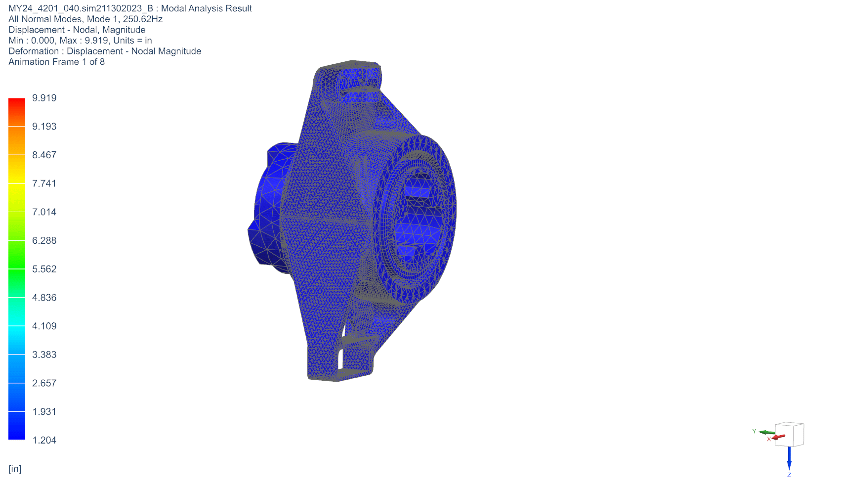
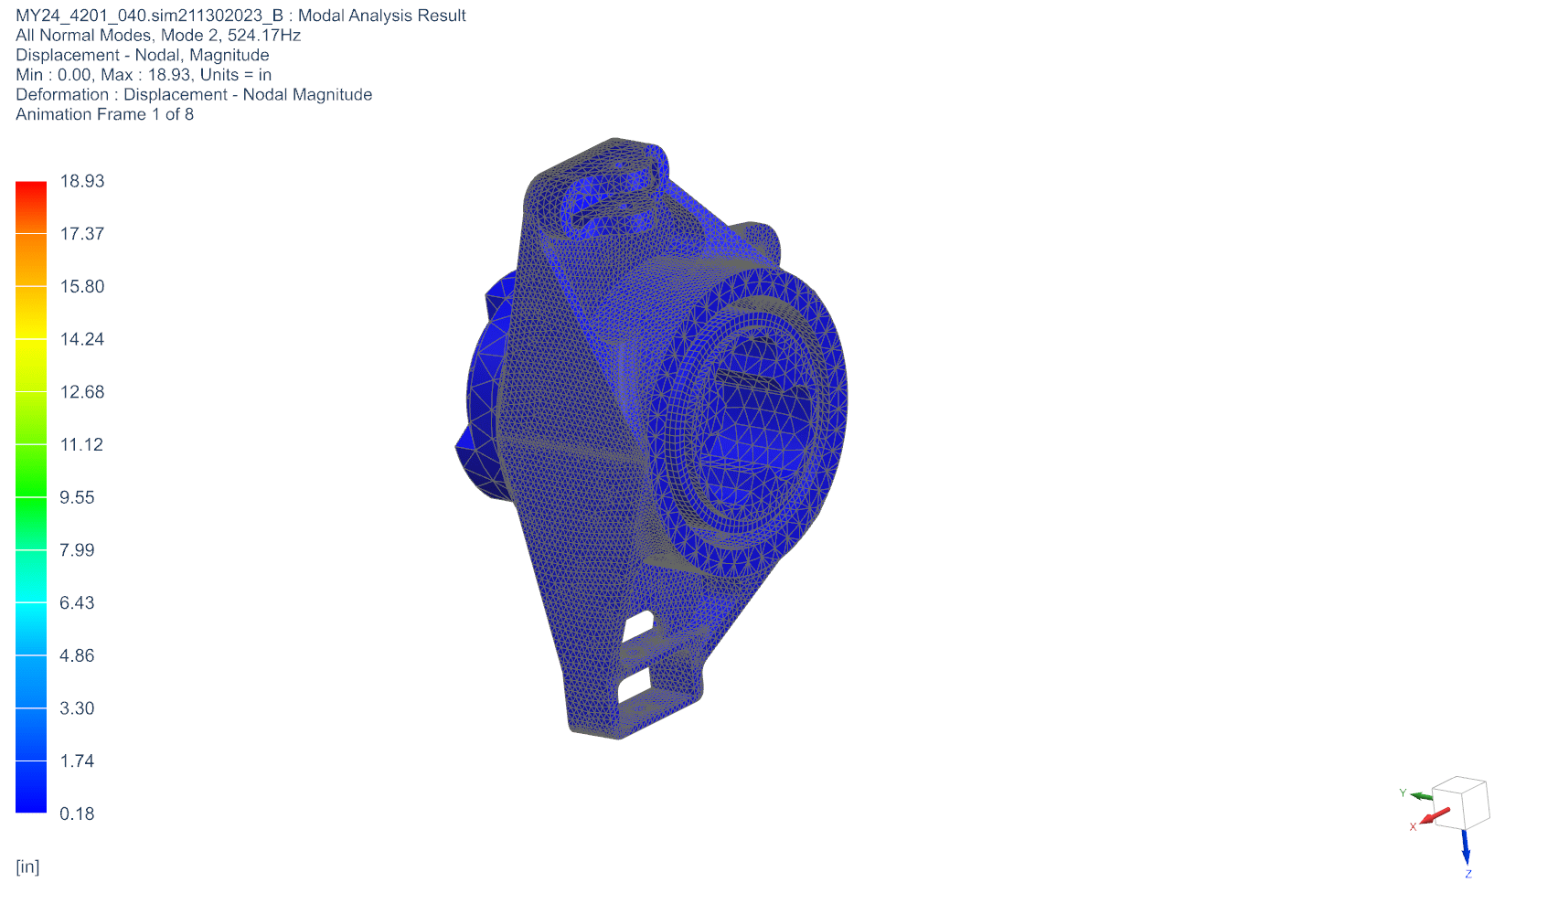
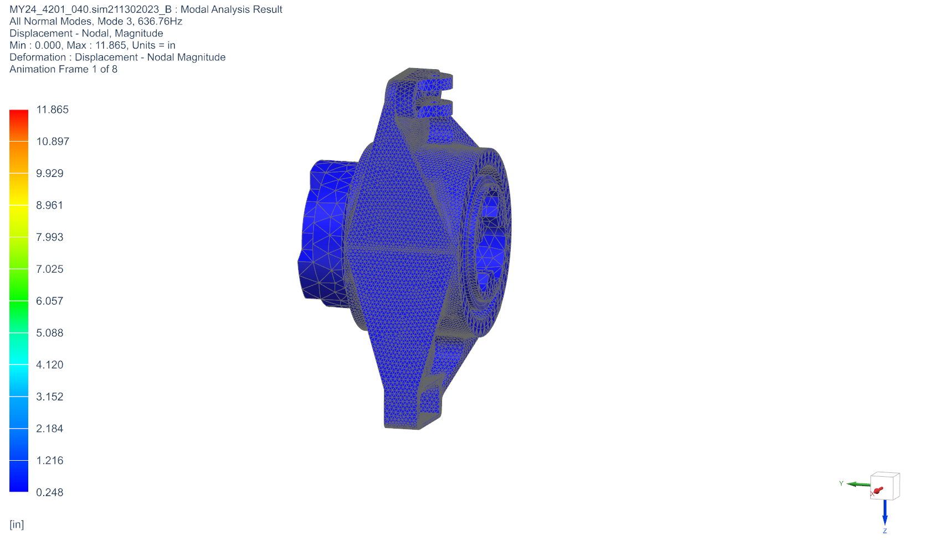
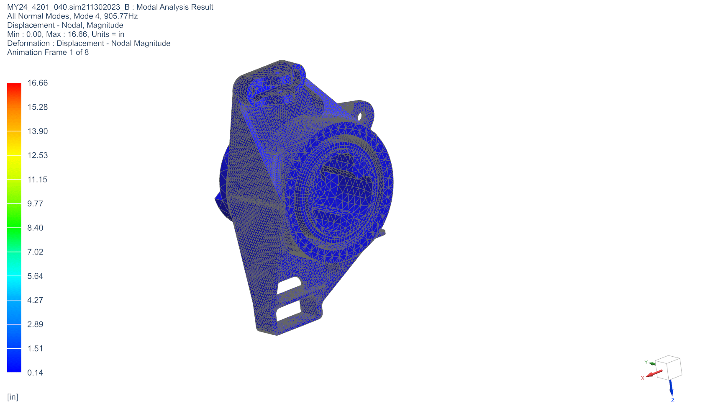
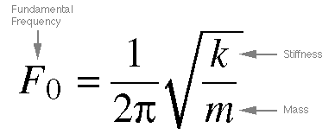
Simulation – Modal Analysis
Resonant failure modes
Treat upright like a tuning fork – what frequencies would it vibrate at?
First-order specific (mass-weighted) stiffness
250Hz
524Hz
636Hz
905Hz
Notes:
Maximum character recommendations:
Contact info: 145
Main title: 38
Secondary title: 100
Update all text fields with your relevant information.
Logo: To add your logo, delete the placeholder logo. Click the placeholder icon and select your logo from your files. Right click and select crop to re-crop your logo to fit in the space. Adjust logo size if logo is more vertical or square in shape.

Slide 13
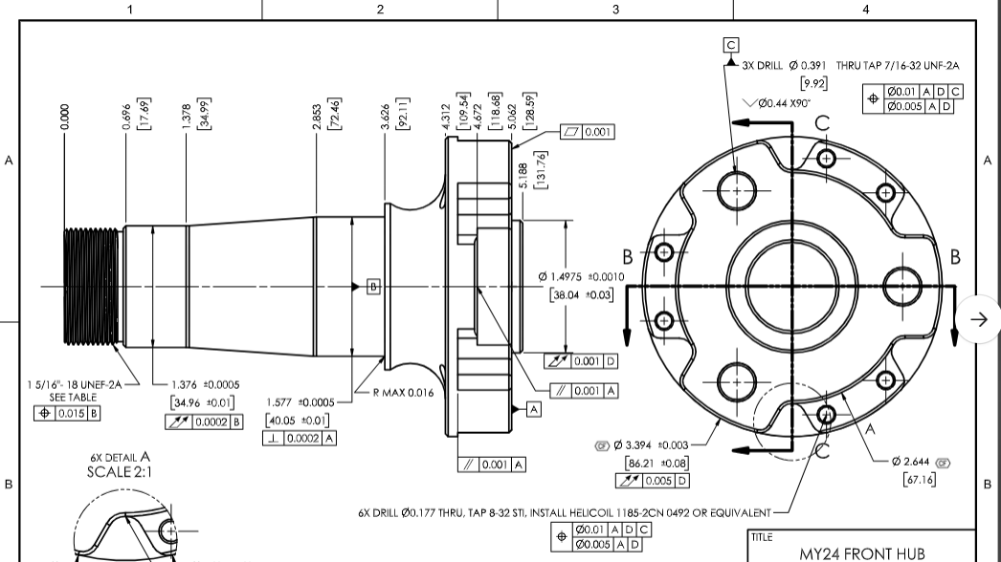
Engineering Drawings
Communicating engineering intent clearly is critical!

Slide 14
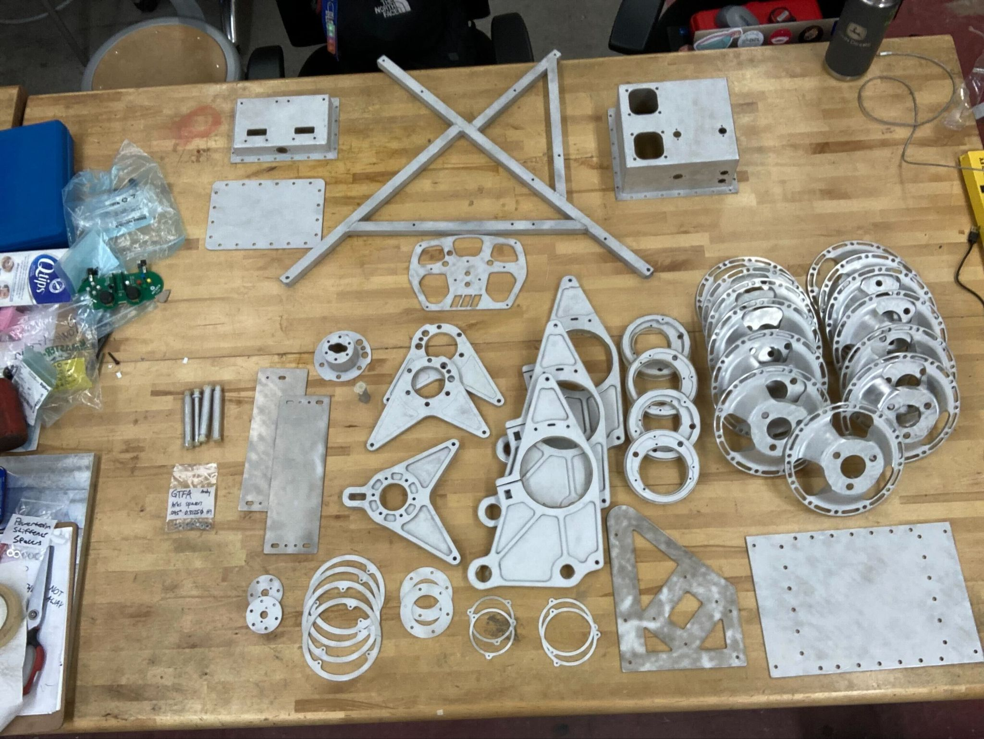
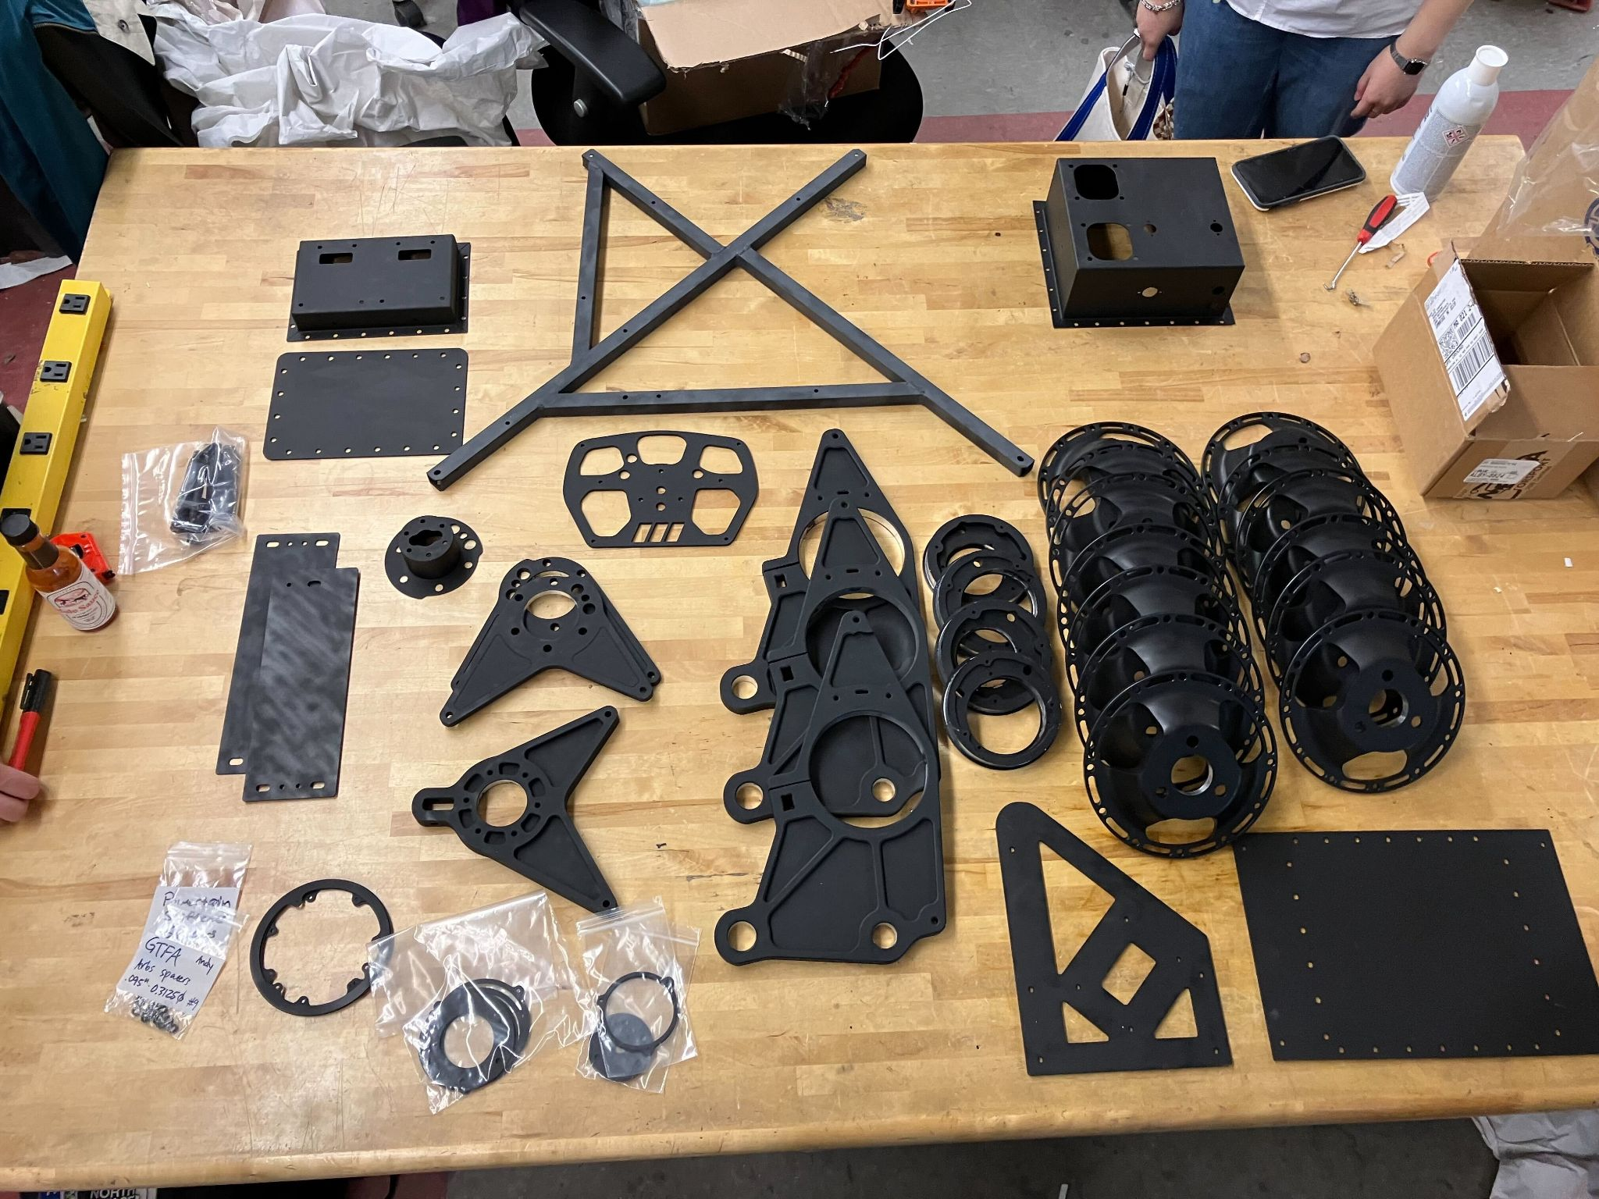
Manufacturing
Many parts made by students!
In N51 – one of many makerspaces on campus!

Slide 15
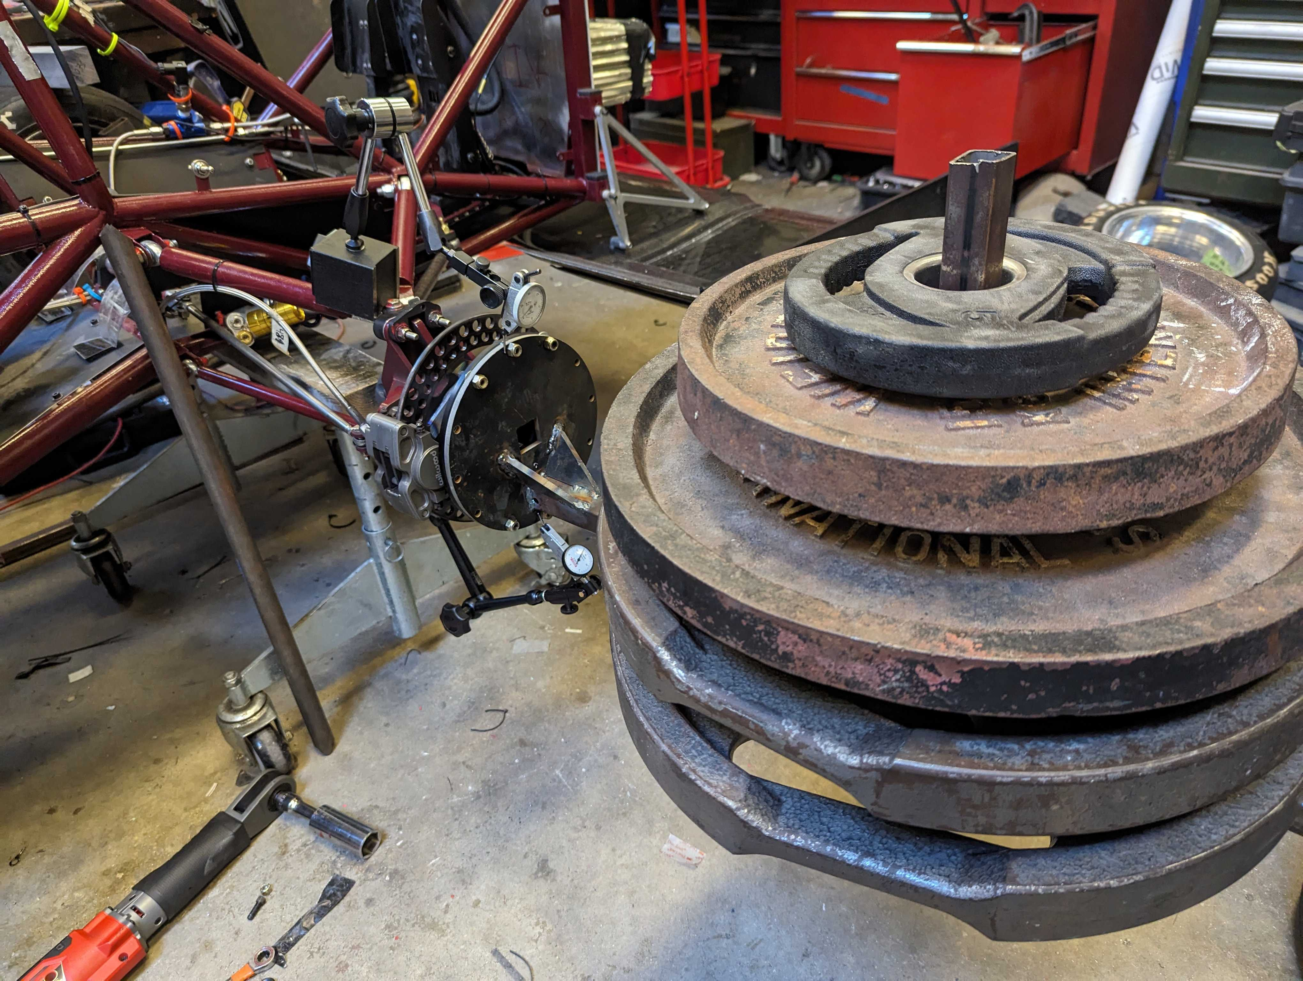
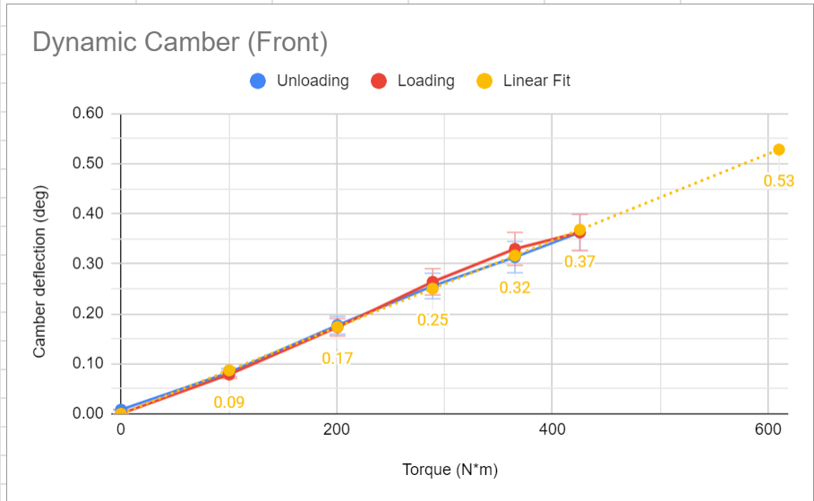
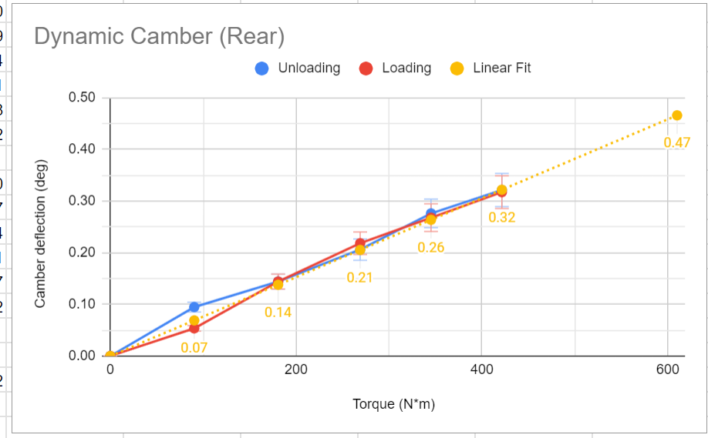
Real World Validation
“Nature cannot be fooled”
- Richard Feynman (MIT B.Sc.)

Slide 16
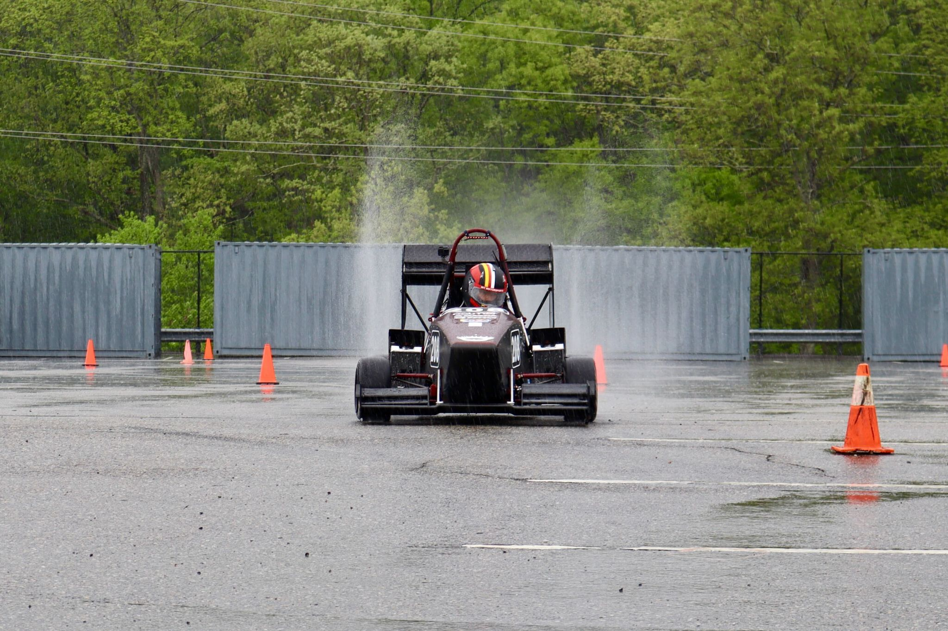
Shakedown
Put the car through its paces!
Build capability slowly, take caution, and check all your safety systems first
(Testing procedure needed w/measurable variables – 2.671)

Slide 17
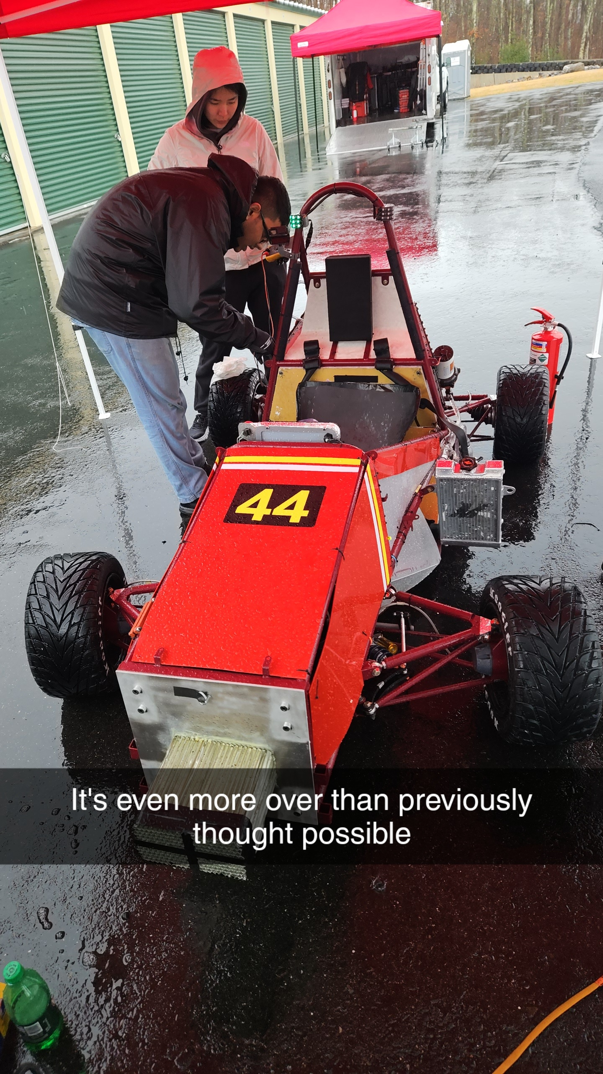
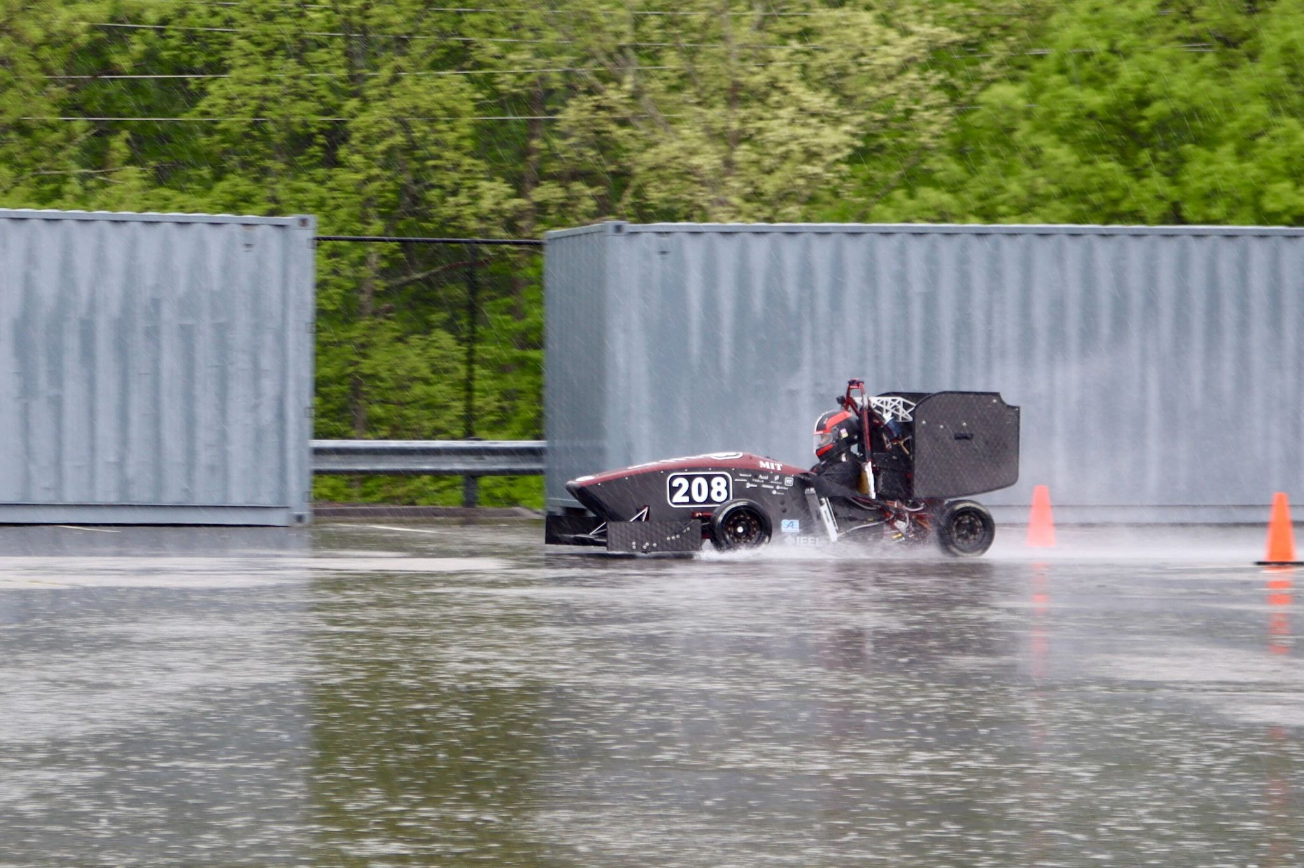
Shakedown… oops
Fire extinguisher ☺
Things will break! – “Integration Hell”

Slide 18
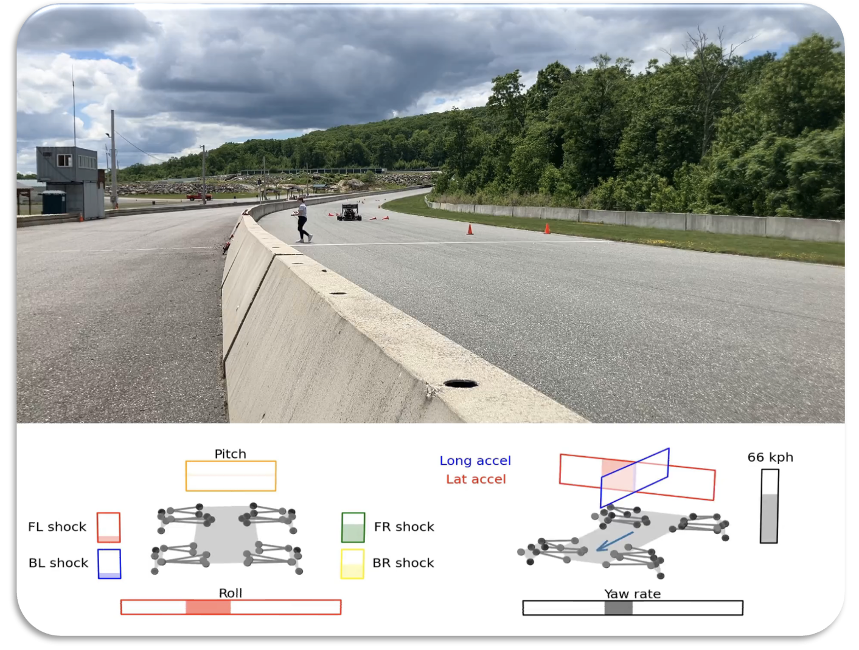
Collect & Use Data!
System as a whole needs to be tuned.
Full vehicle dynamics model
This is why teams win 🏆

Slide 19
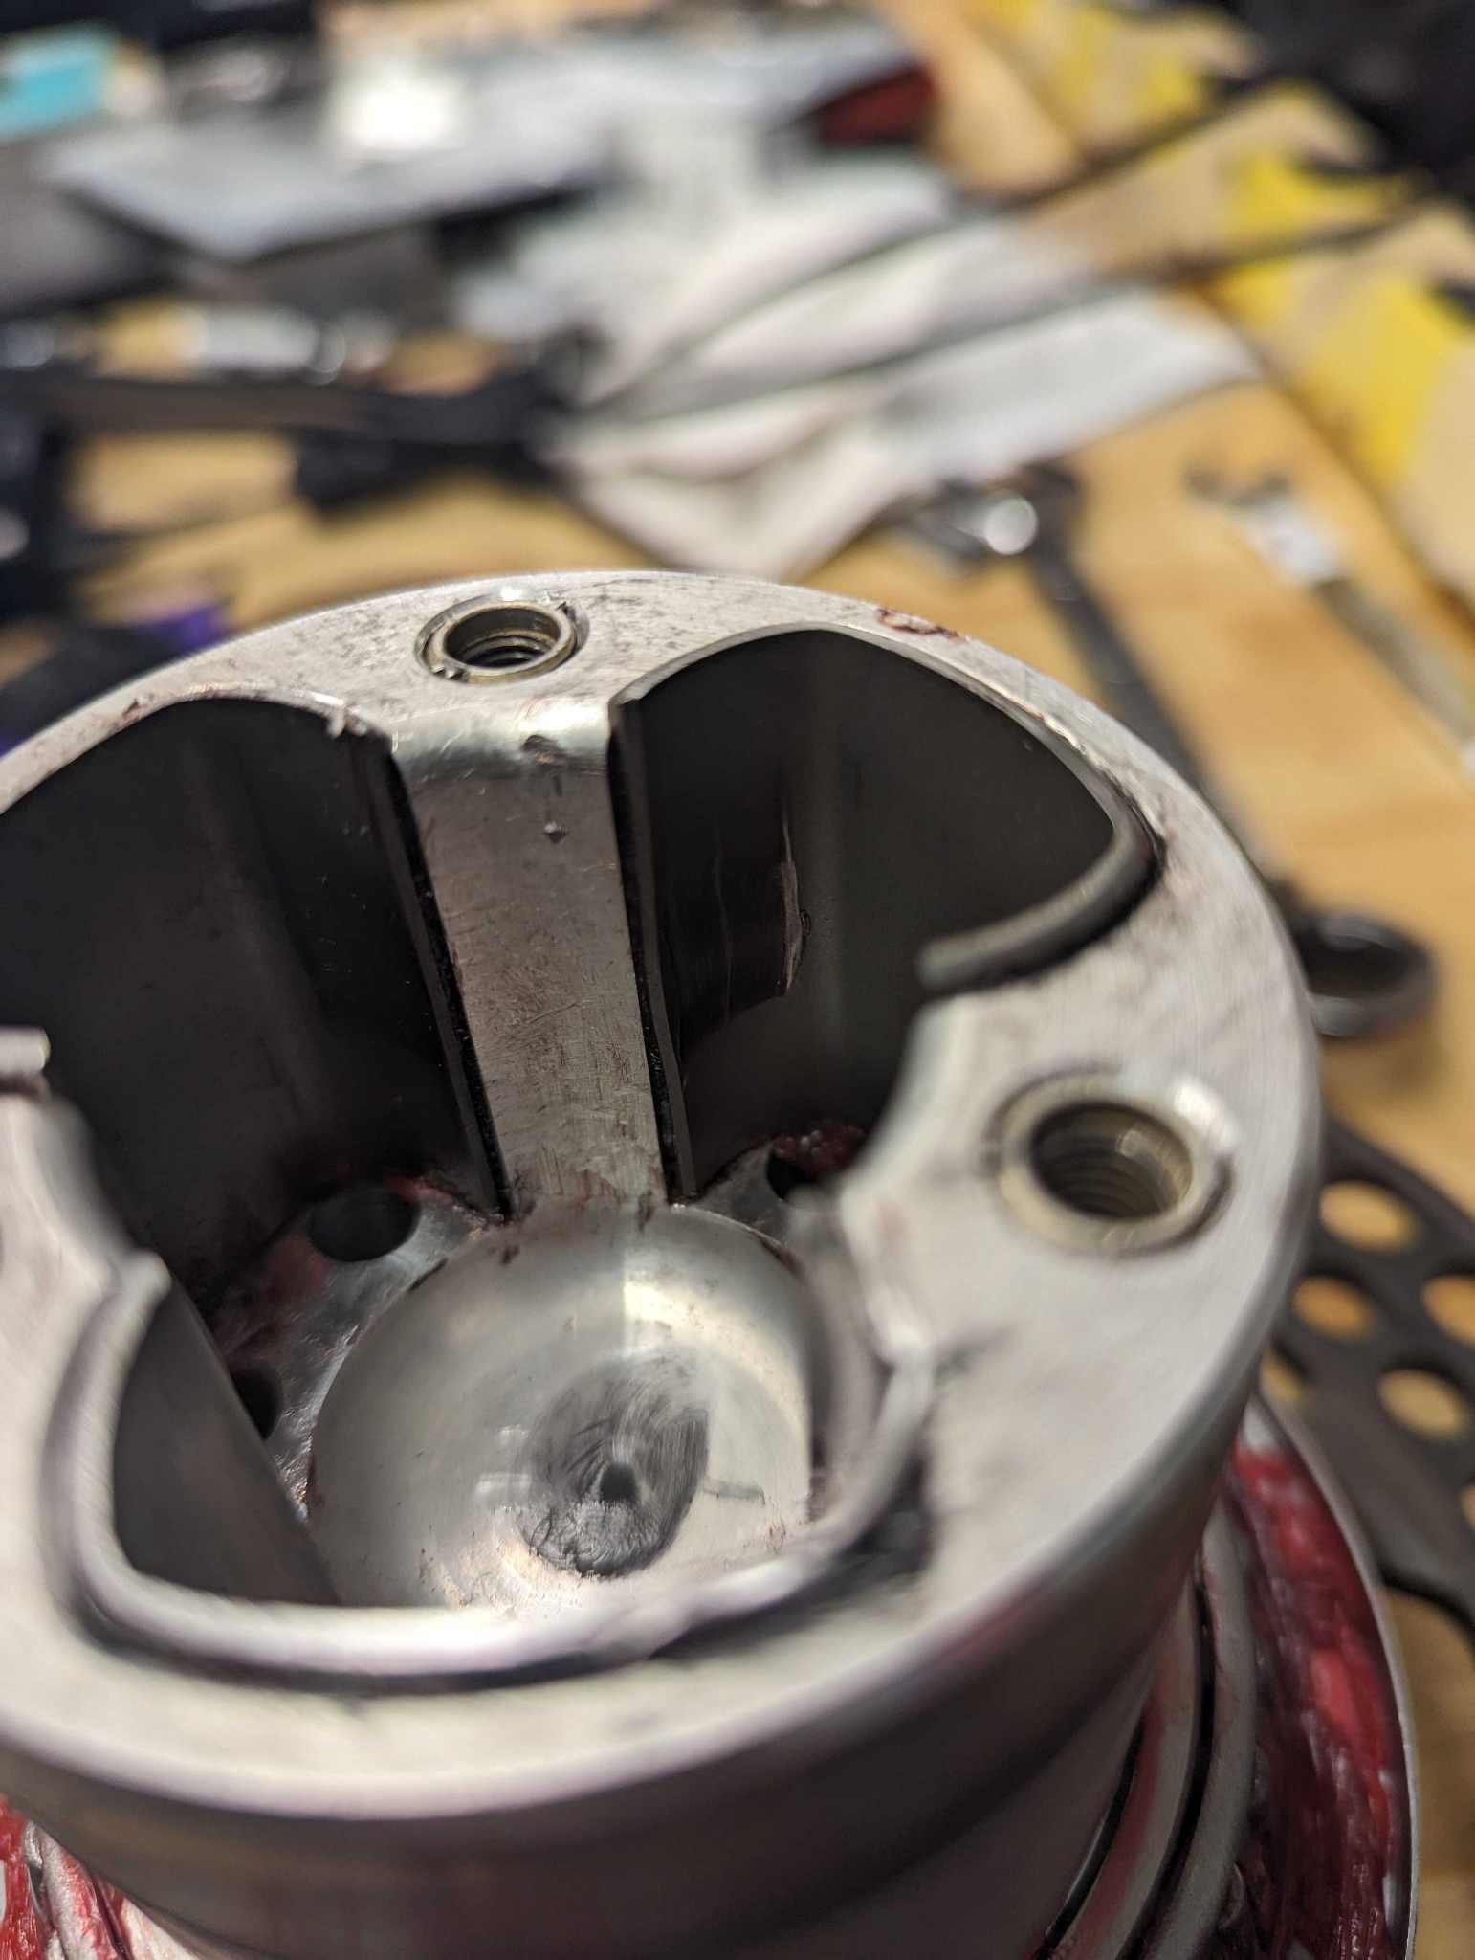
No matter how much validation you do… Stress exceeds allowable due to Hertzian contact stress, fatigue – 300km
Spot it?

Slide 20
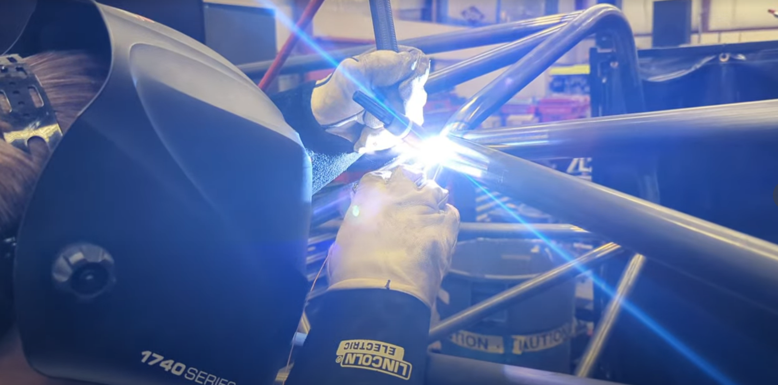
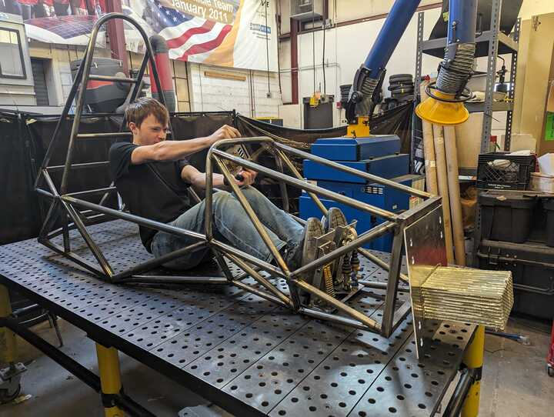
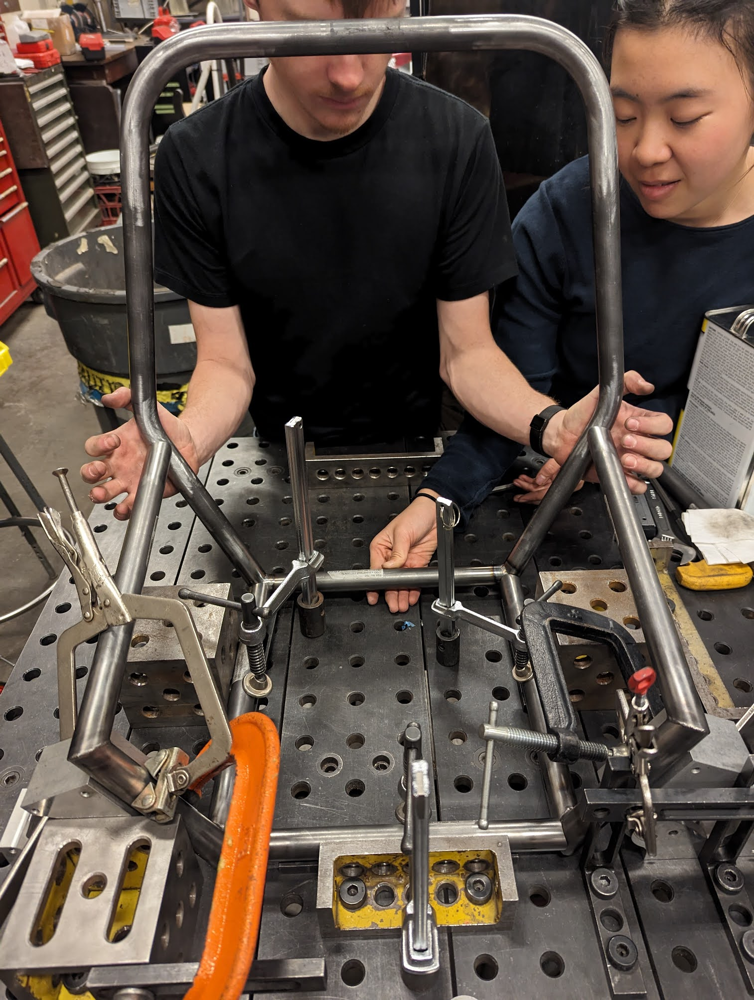
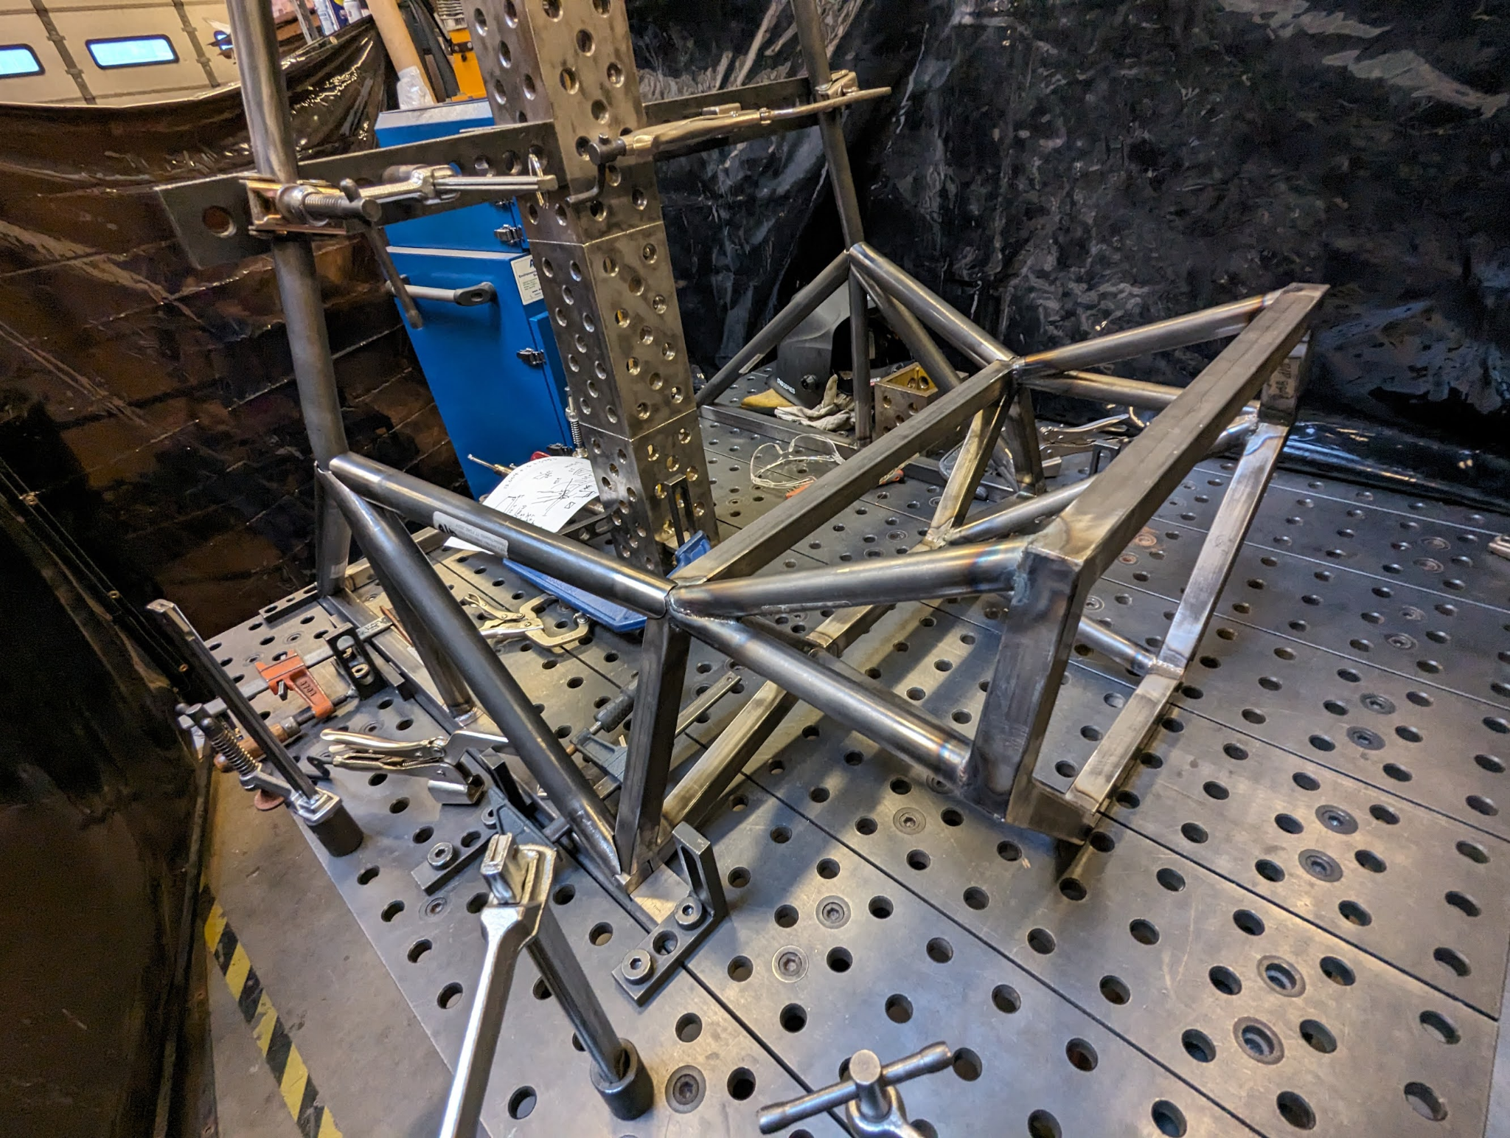
System Highlight - Frame
Welded fully in-house in ~35 days (over IAP)

Slide 21
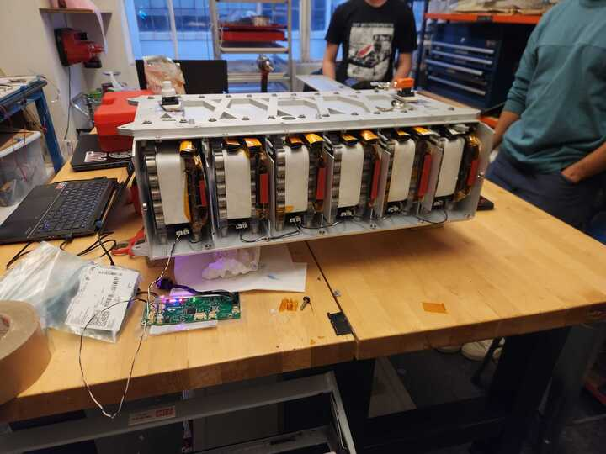
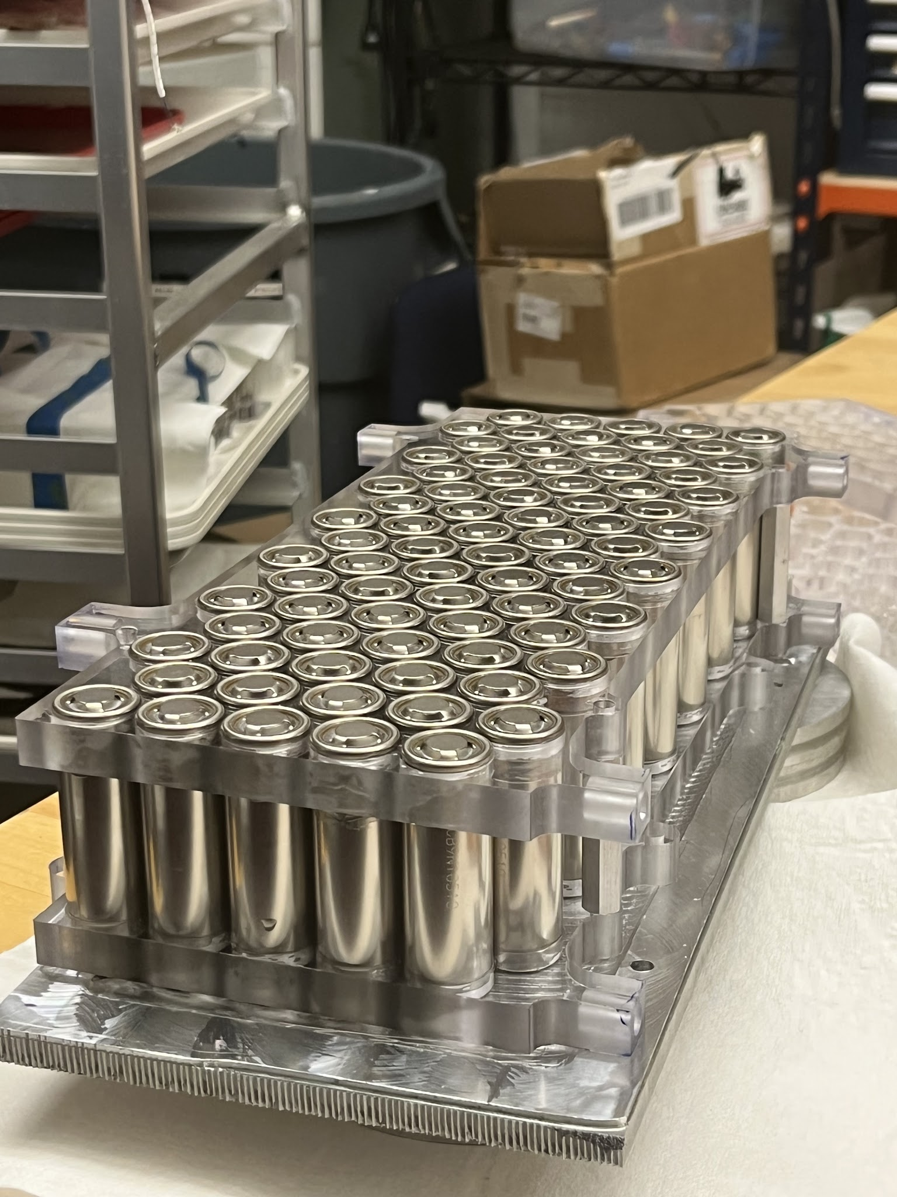
System Highlight - Battery
Liquid-cooled, student designed and built
7.6kWh, 400V, 96s5p, P45B cells

Slide 22
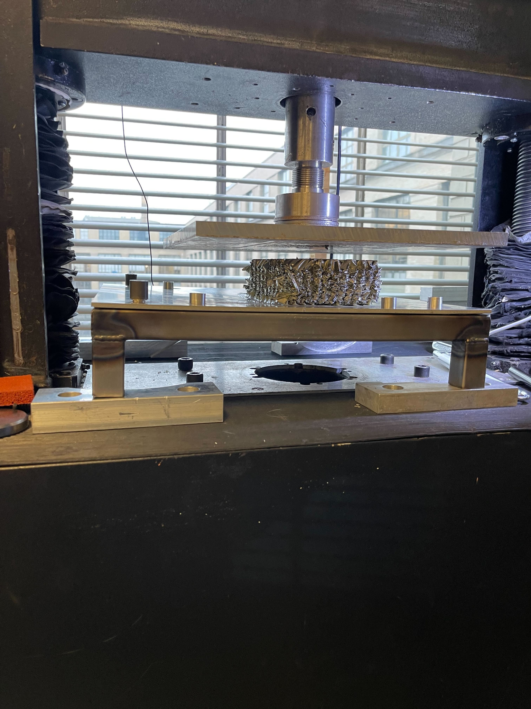
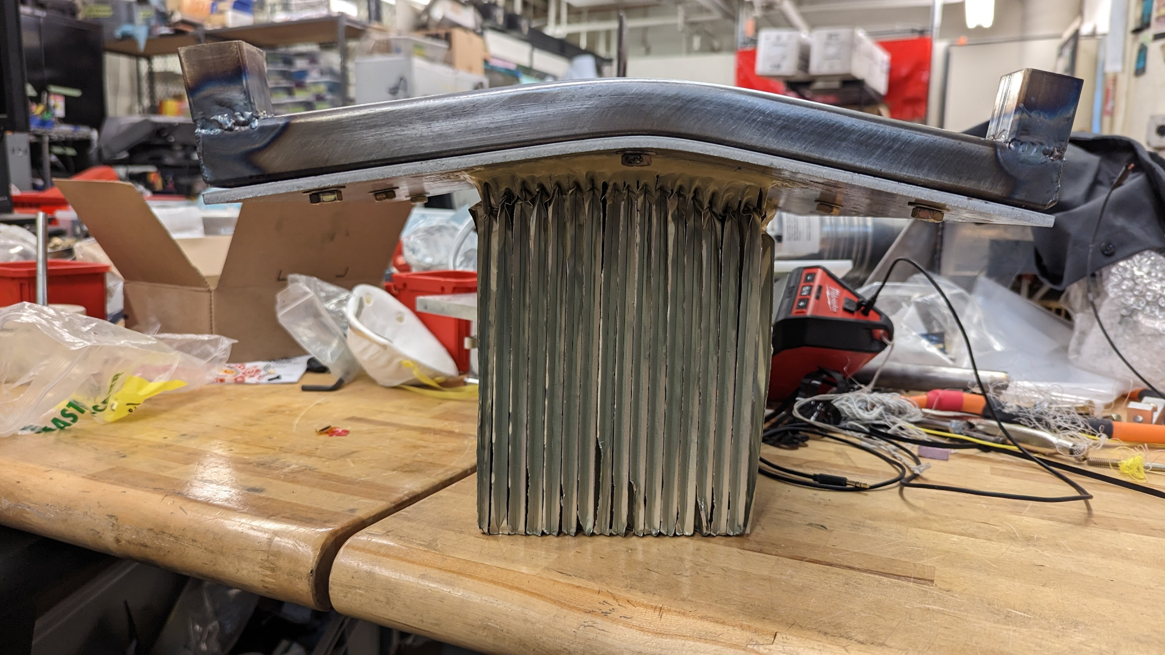
System Highlight – Attenuator
Absorbs impact in event of a head-on collision. Similar to Falcon 9 landing legs

Slide 23
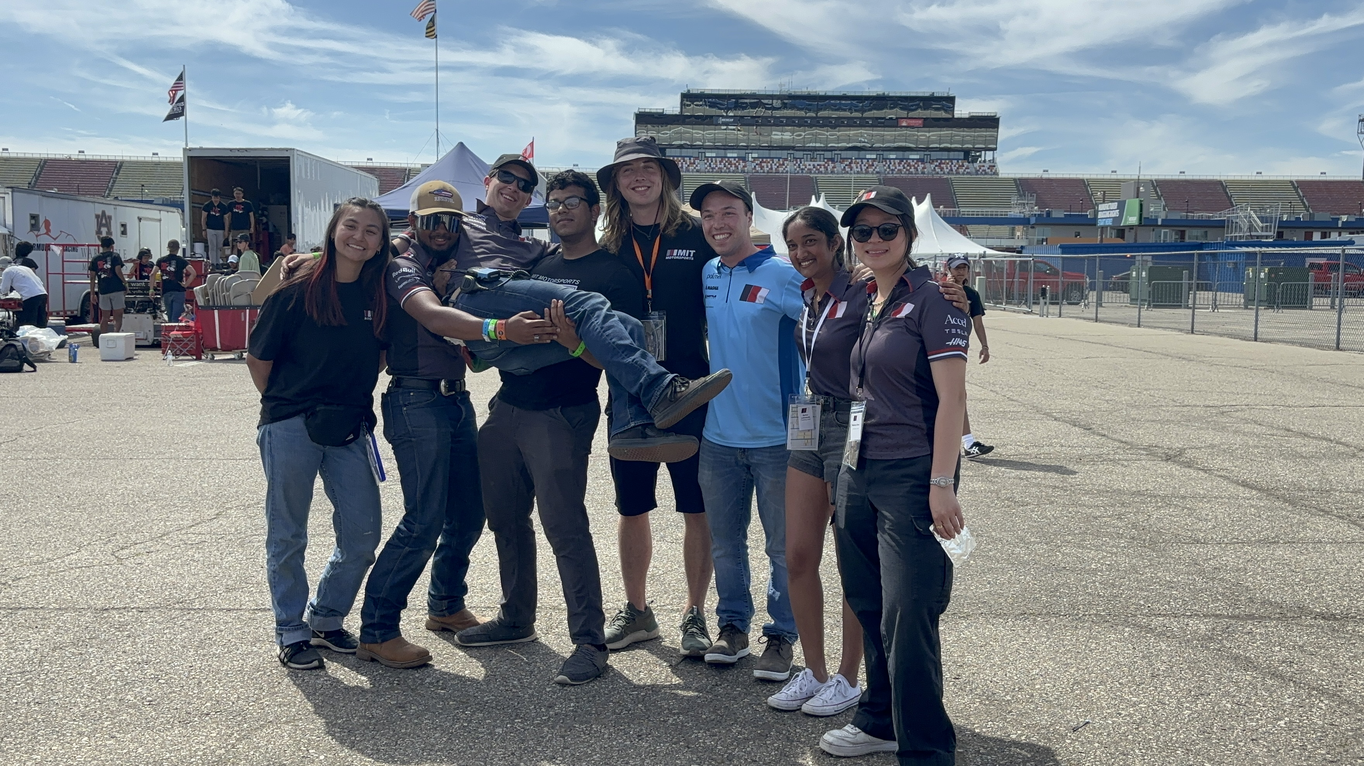
Thanks!!
Henry, Megan, Rakib, Faris, Abe, Sehar, Monica (C/O ‘25)
Patrick McAtamney (N51 Shop Manager)
Peggy Eysenbach (Shared cookie recipe!)
All Edgerton Center staff!!
“The Senior Hug”
Notes:
Maximum character recommendations:
Section divider: 35
Secondary description: 130

Slide 24
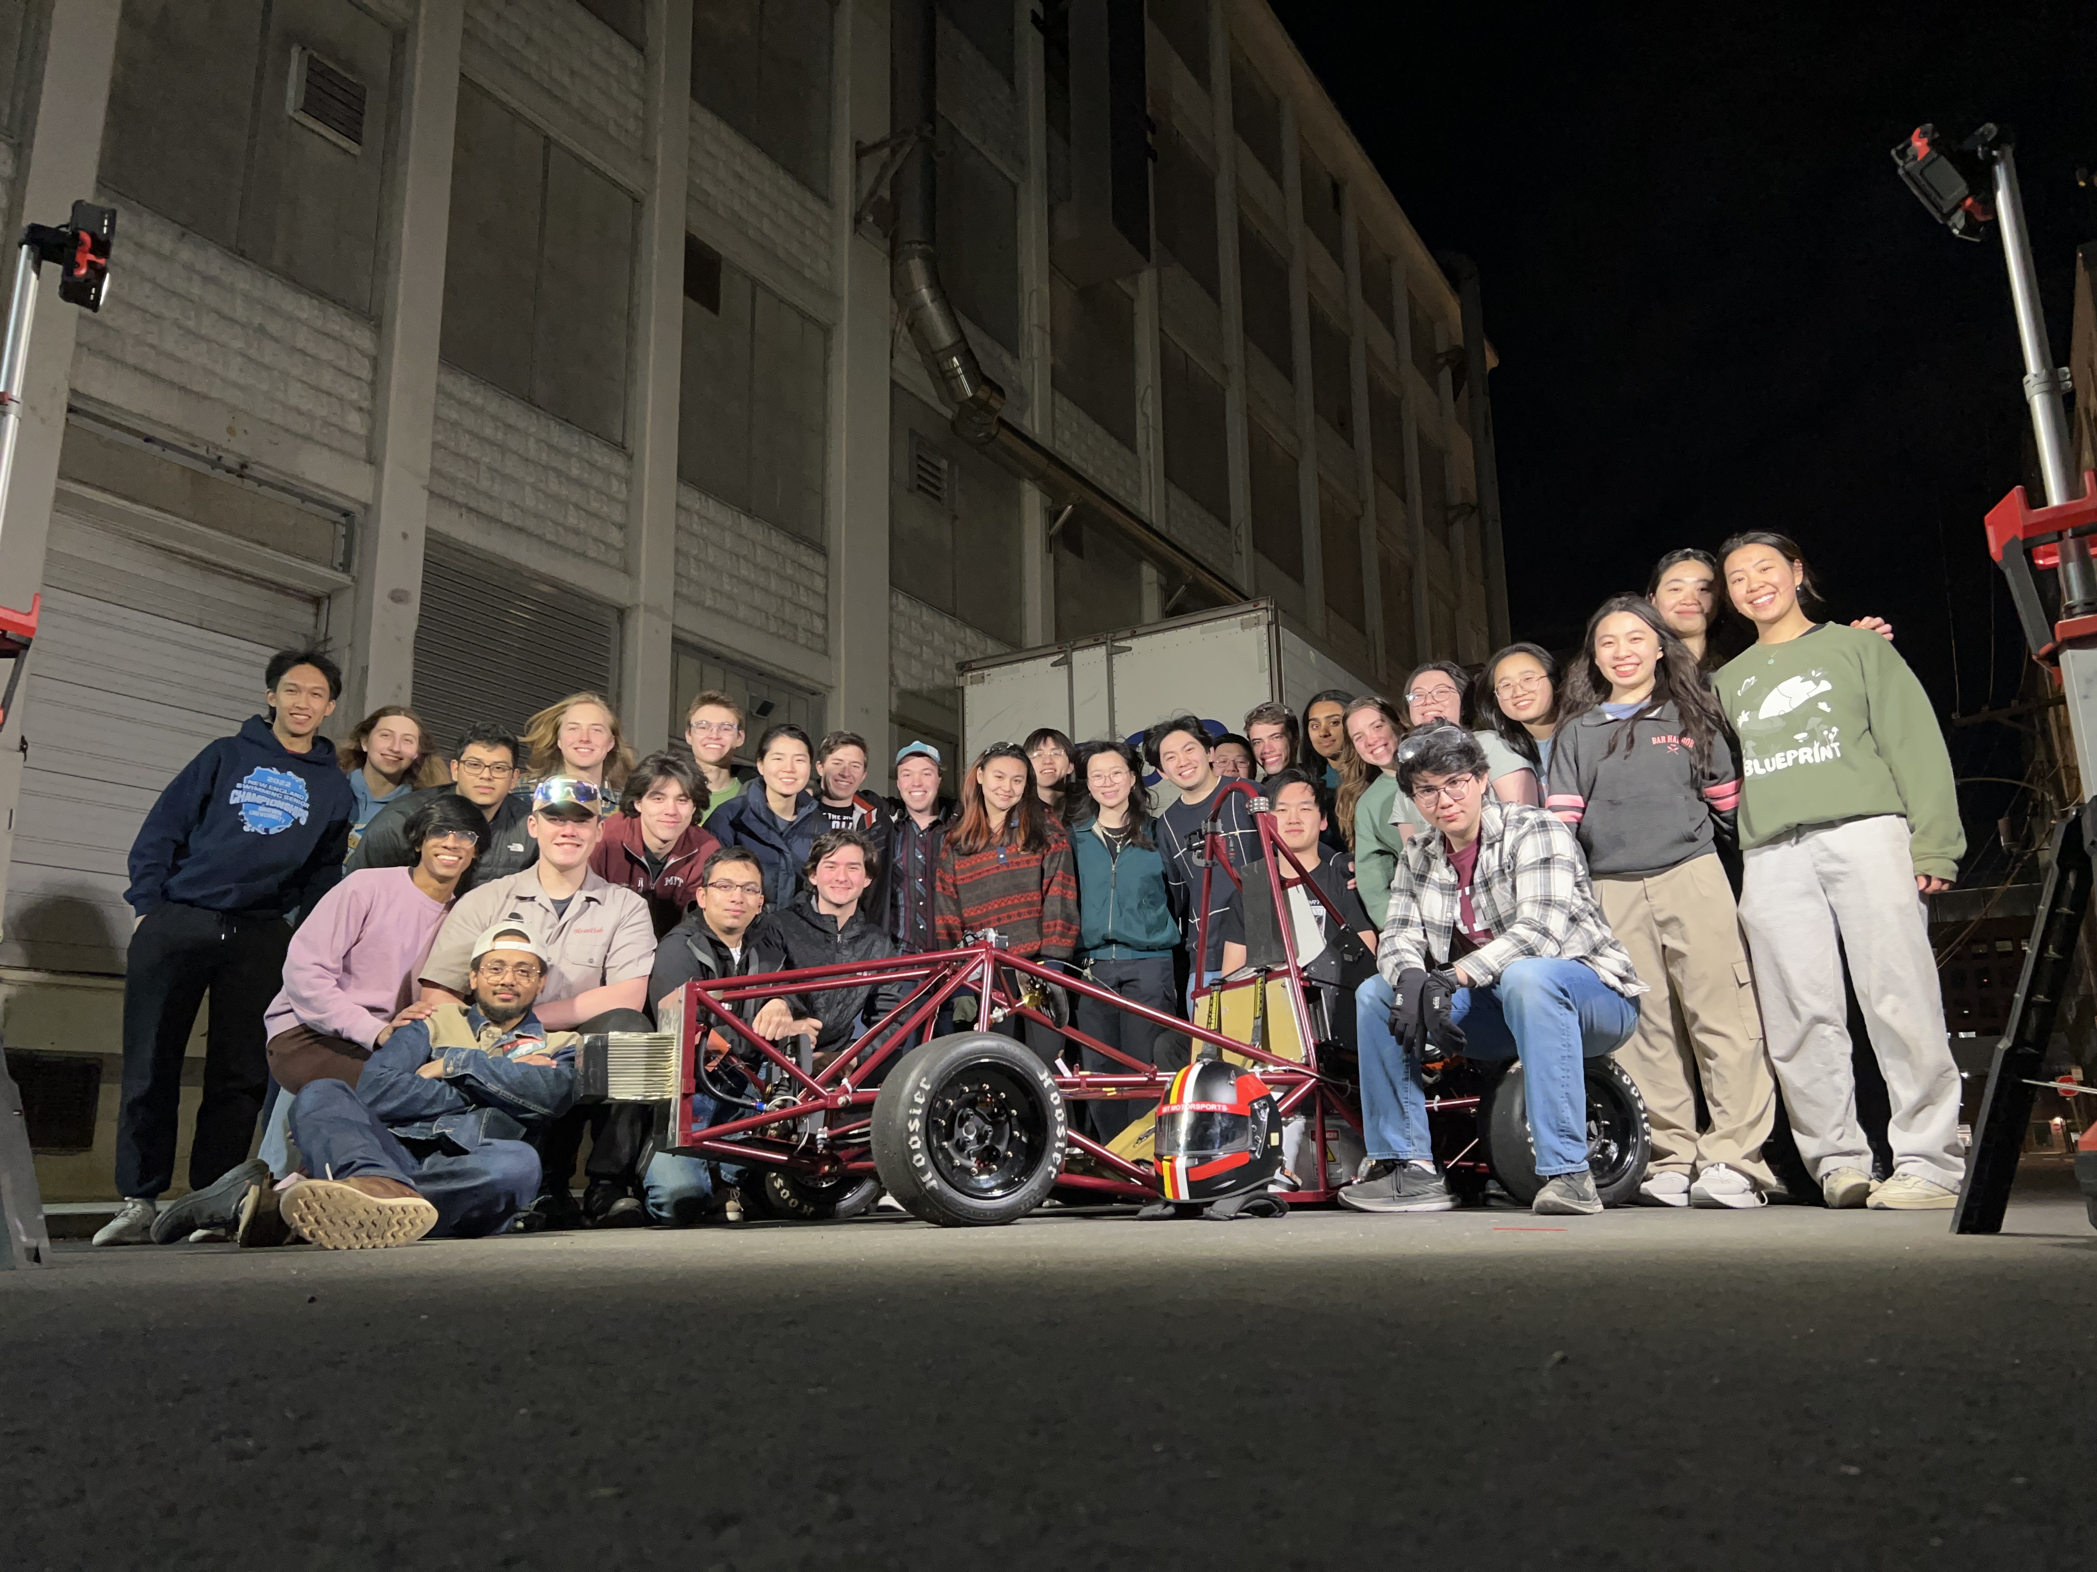
Thanks!!
All my teammates ☺
Post-Roman
(at 4am)
It’s been an honor
Notes:
Maximum character recommendations:
Section divider: 35
Secondary description: 130

Slide 25





Thanks!!

